Slide 2
Neural Object Detection
Ilya Zakharkin | Deep Learning School

Slide 3




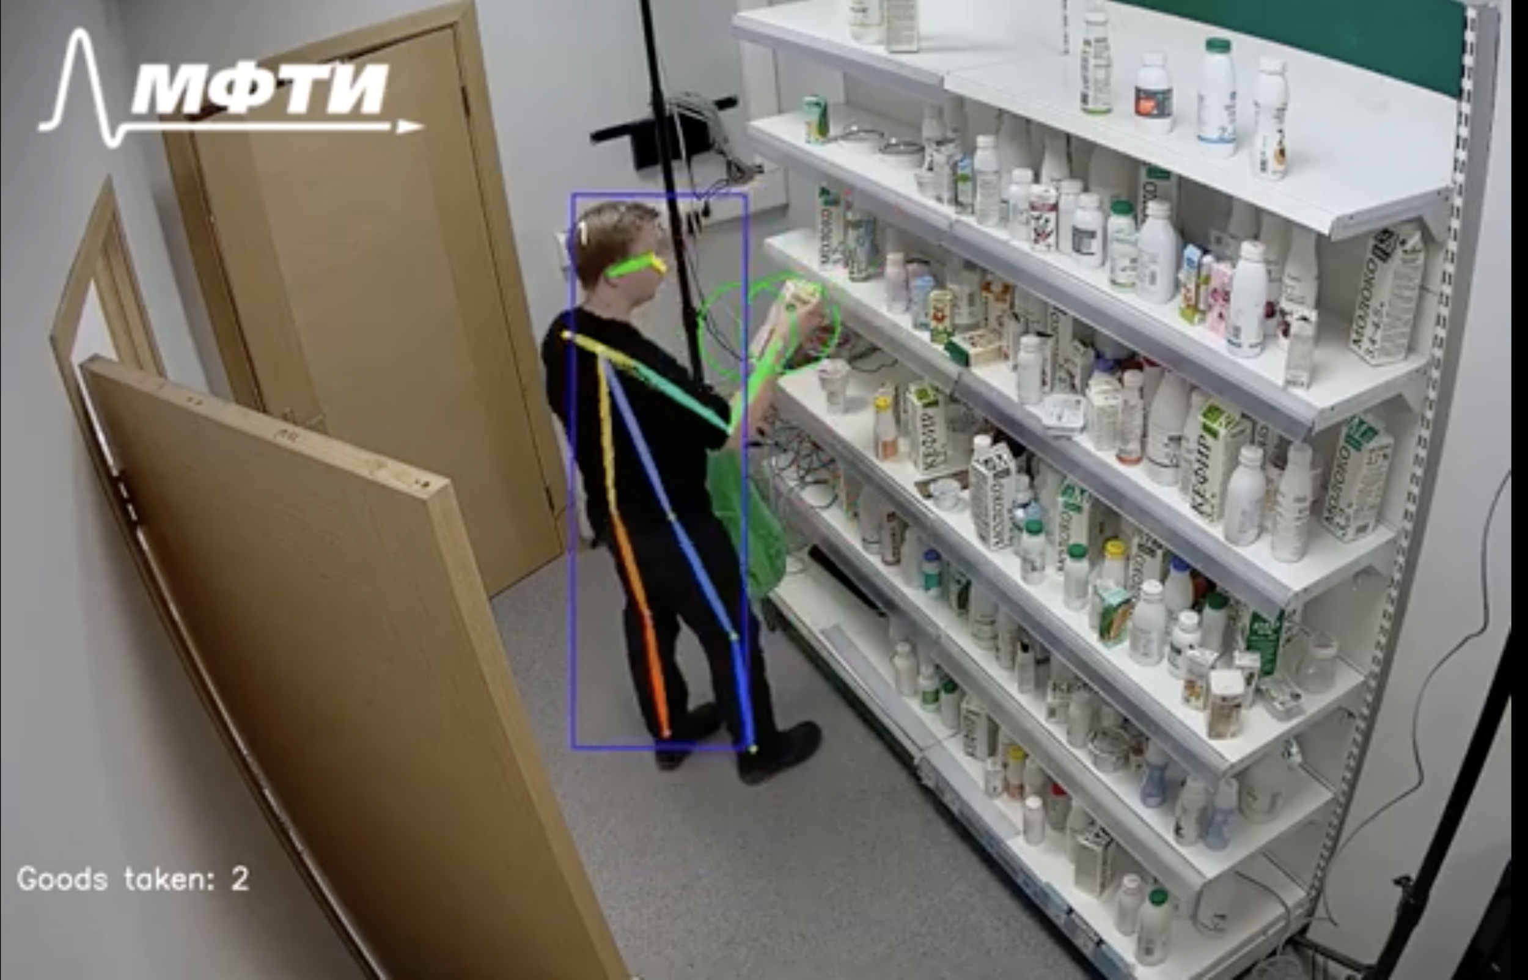

About

Slide 4


About
https://www.jesture.ai/

Slide 5
Lecture plan
Classification recap
Object Detection basics
Two-stage (proposal-based) methods
One-stage (single-shot) methods
Modern approaches & tasks

Slide 6
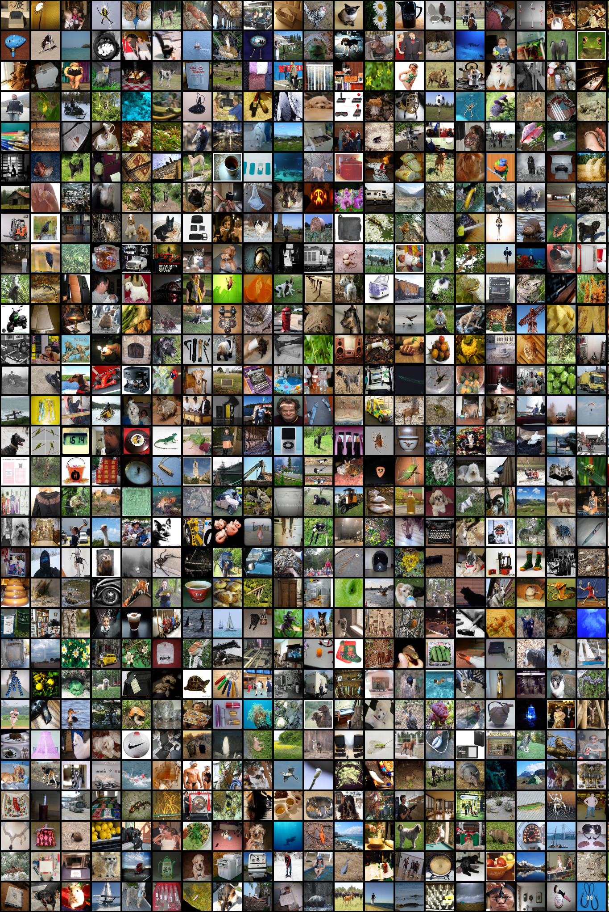
Image
Classification
Recap

Slide 7
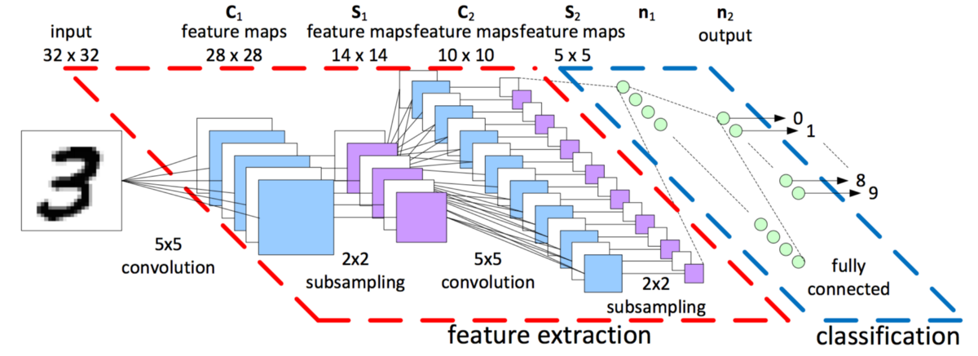

Slide 8
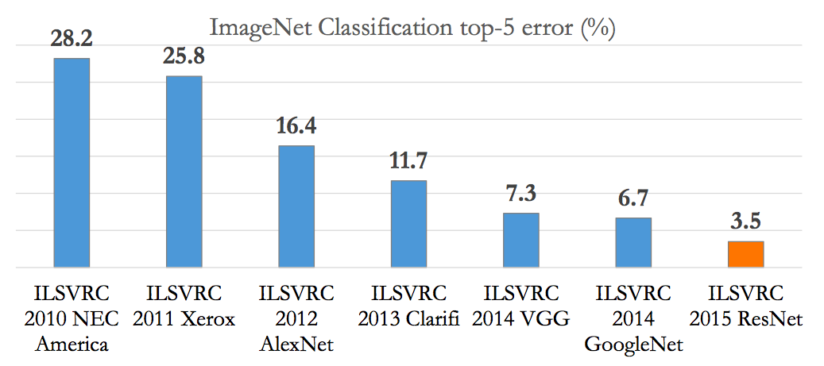
Classification: ILSVRC

Slide 9
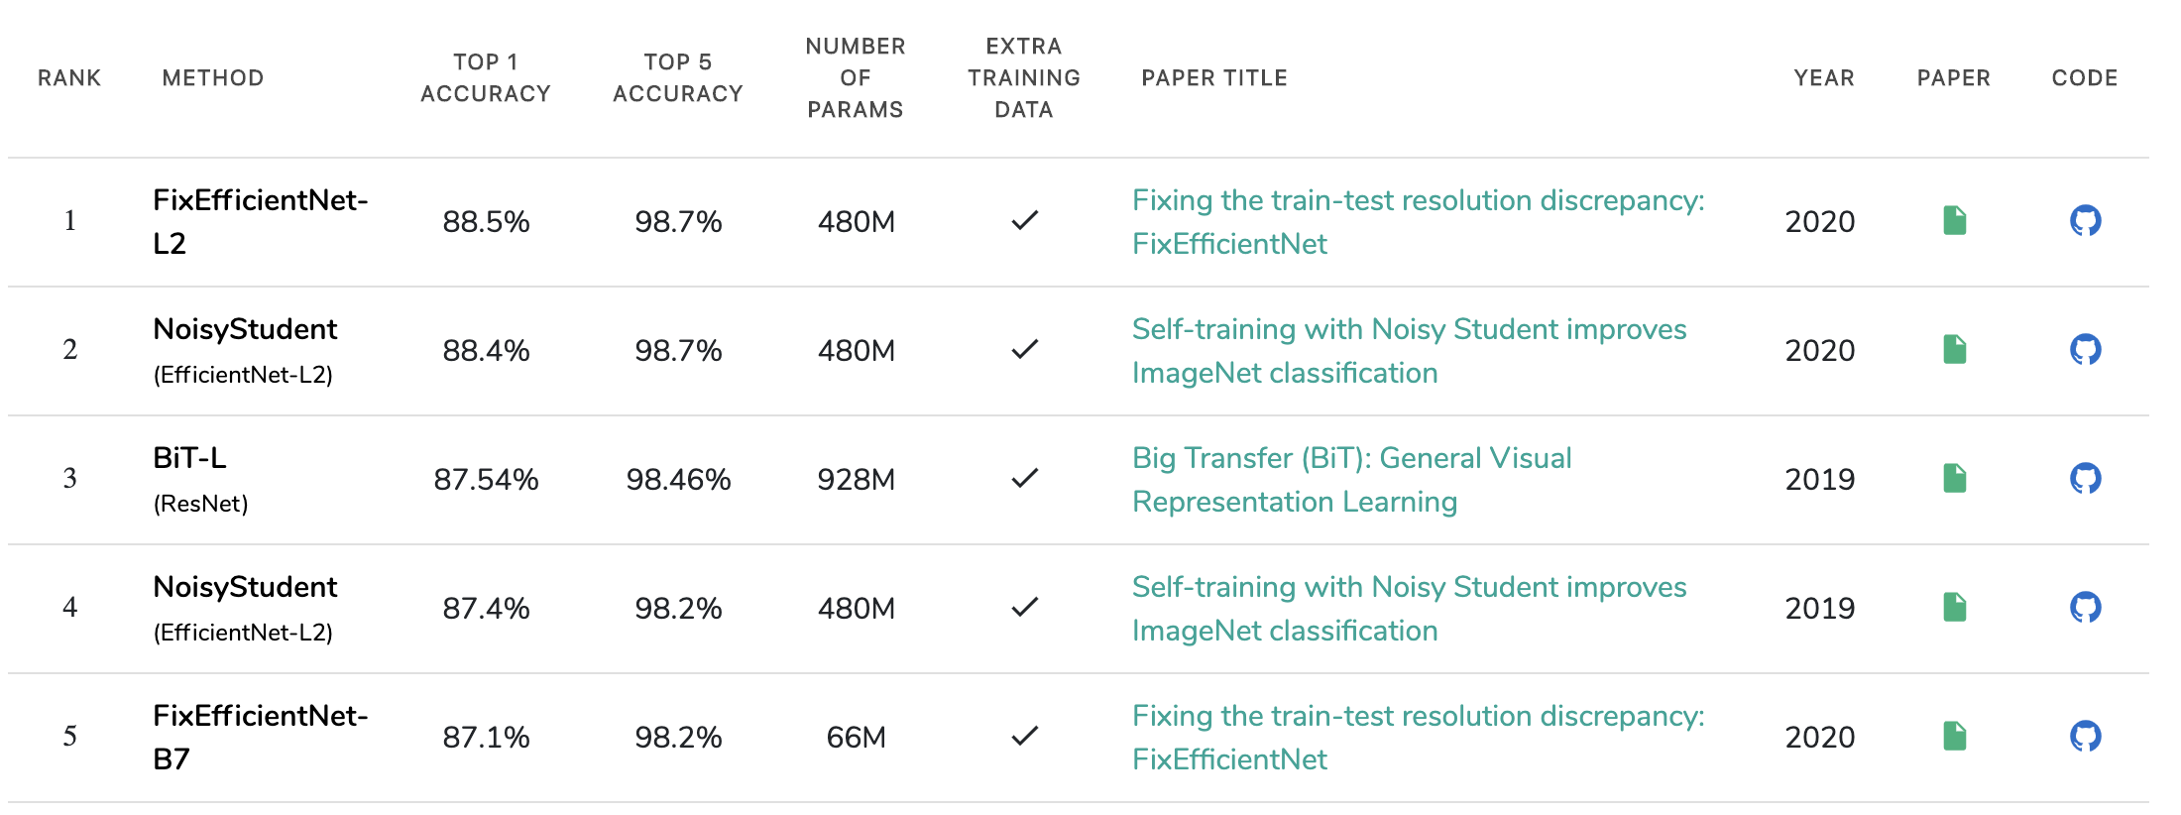
Classification: ILSVRC
https://paperswithcode.com/sota/image-classification-on-imagenet

Slide 10
Classification: ILSVRC
96.5%

Slide 11
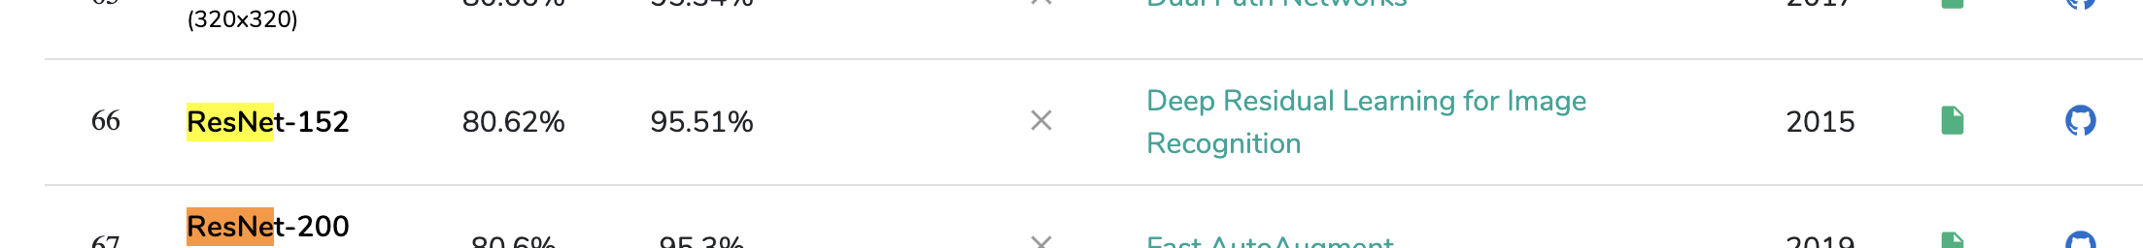

Classification: ILSVRC
96.5%

Slide 12
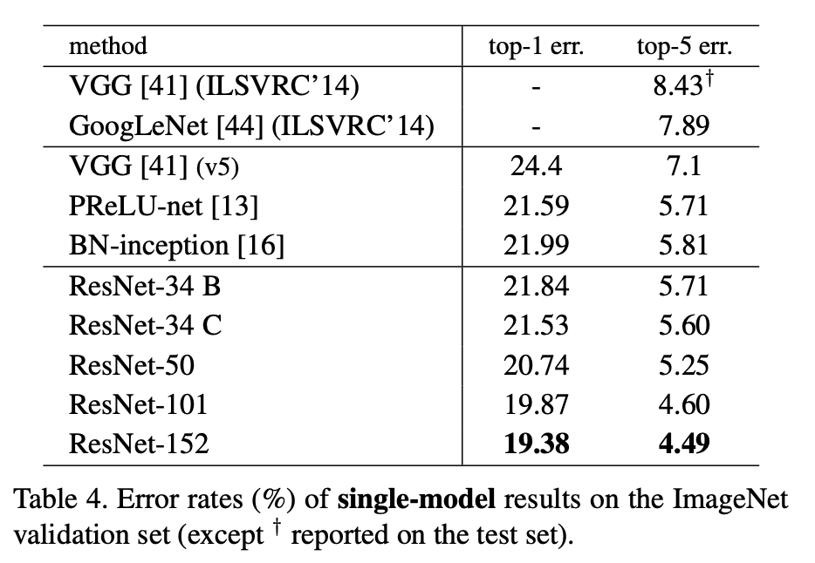
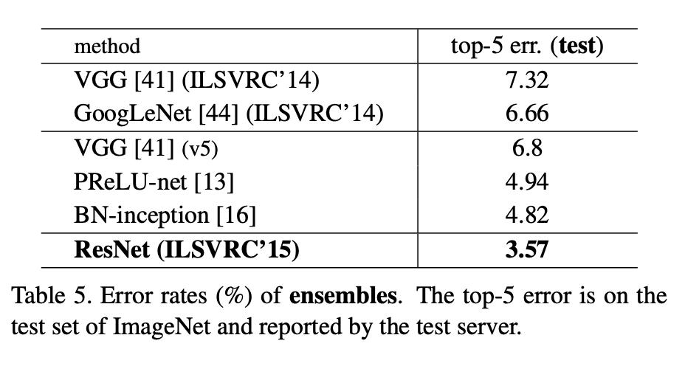
Classification: ILSVRC
https://arxiv.org/pdf/1512.03385.pdf

Slide 13
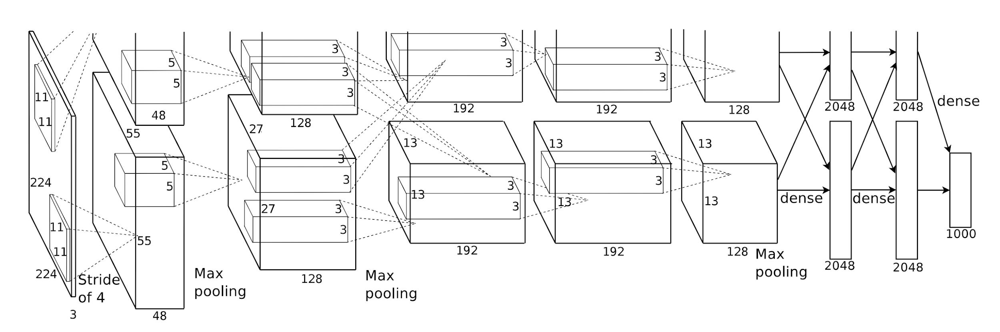
Classification: AlexNet
Idea: Conv -> Conv (= ConvBlock) + Deeper + GPU
Paper
Code: available in every framework

Slide 14
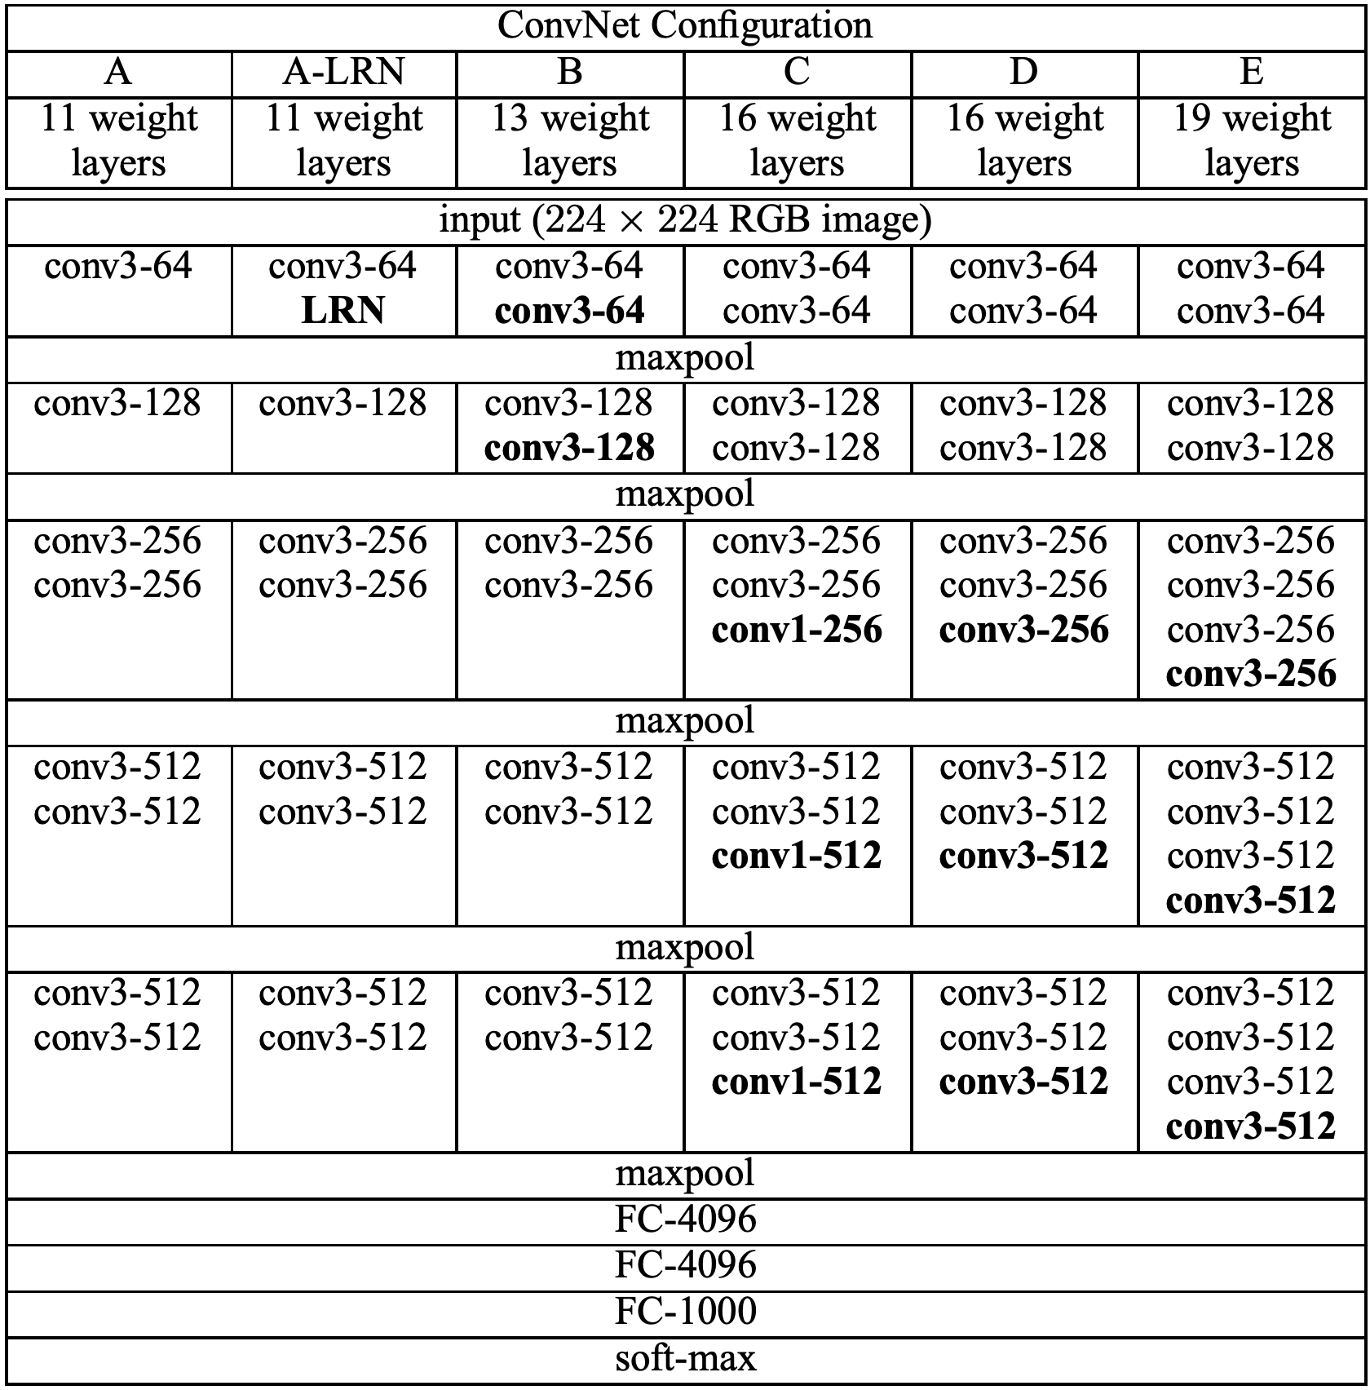
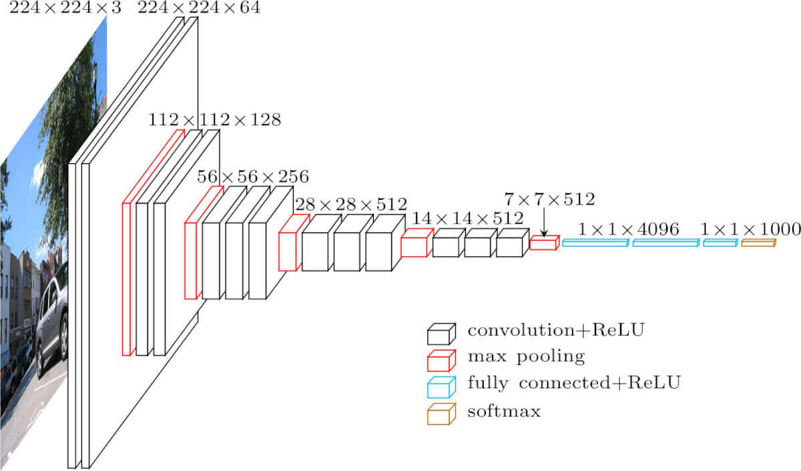
Classification: VGG
Idea: Several conv blocks (deeper net)
Paper
Code: available in every framework

Slide 15
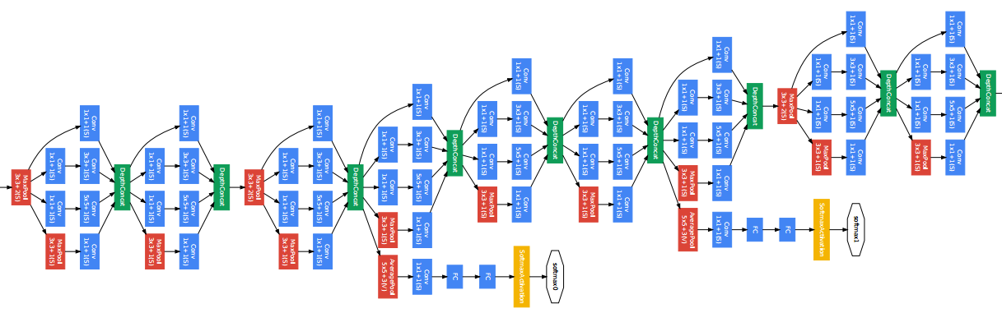
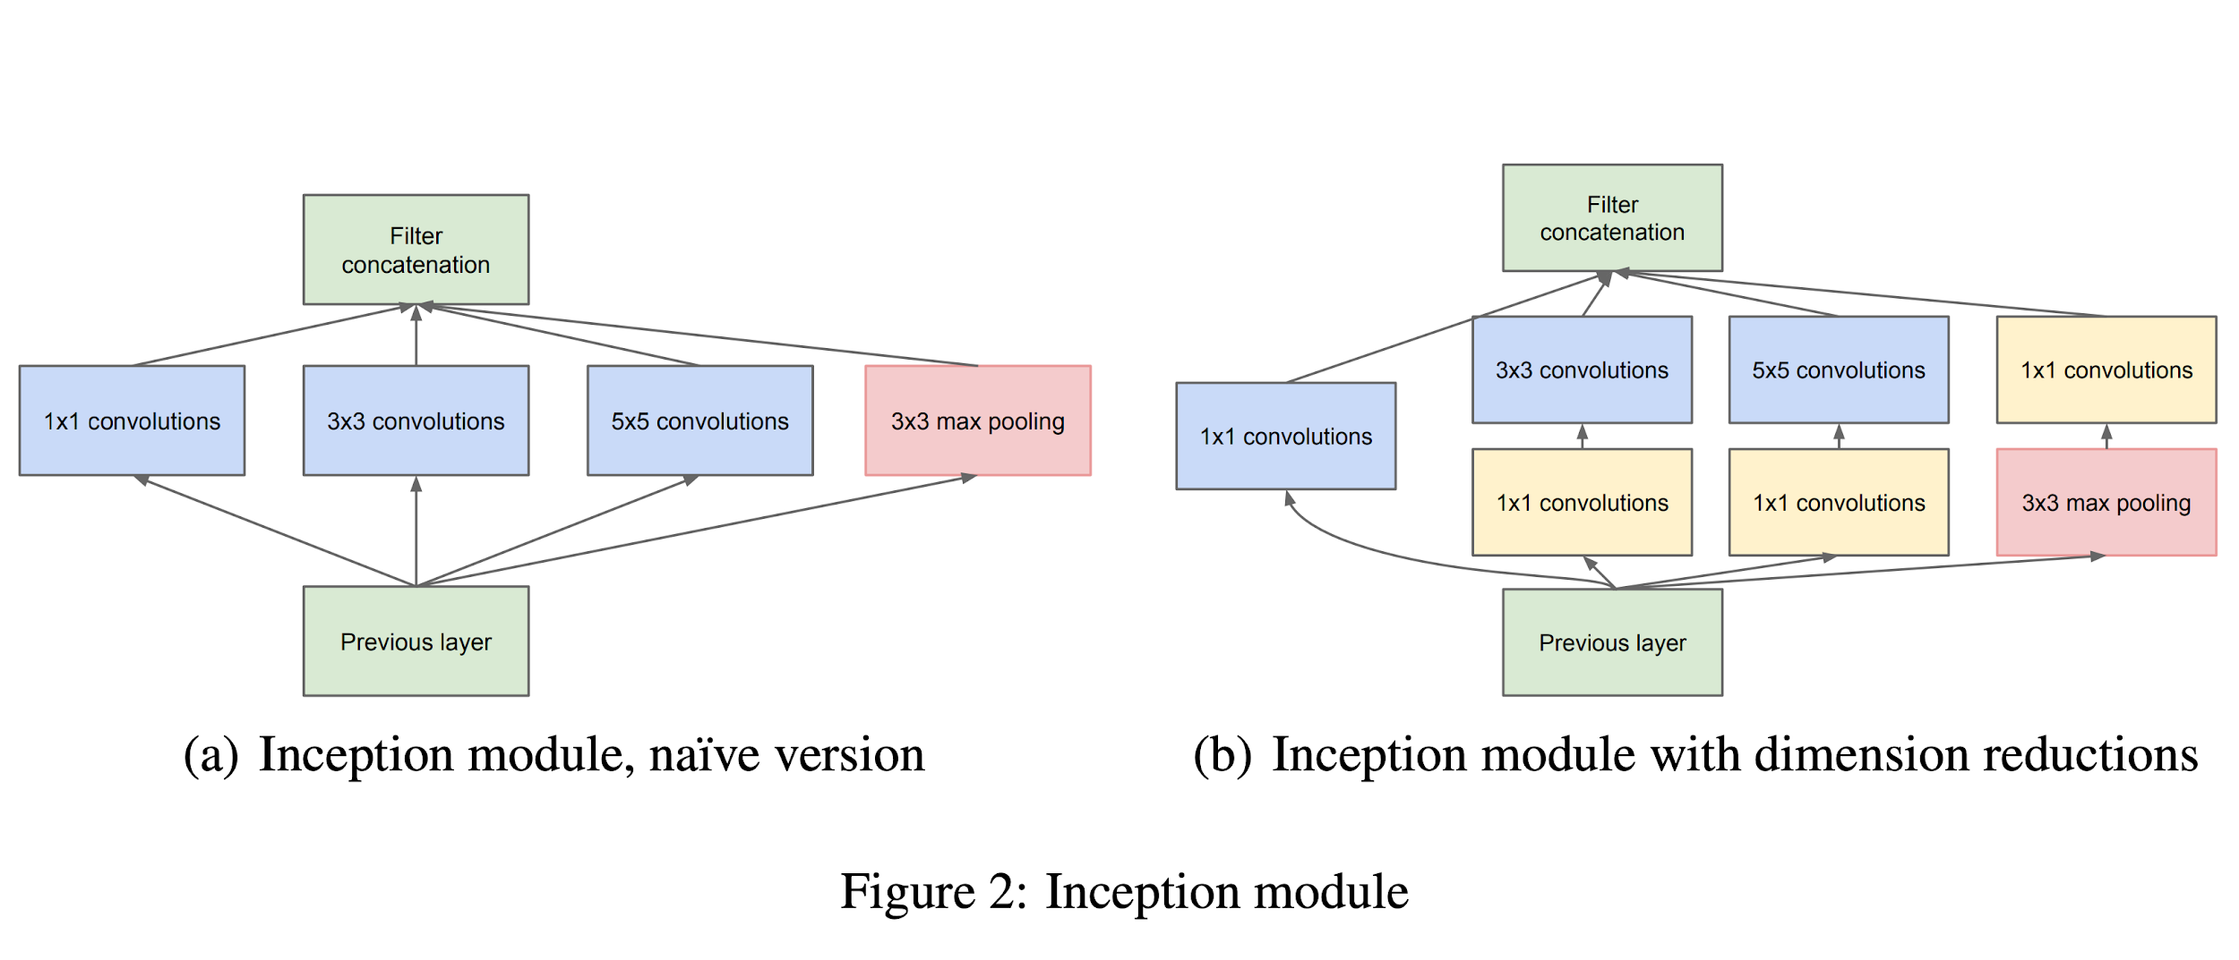
Classification: Inception (v1)
Idea: Inception-block + 1x1 conv + deep supervision
Paper
Code: available in every framework

Slide 16
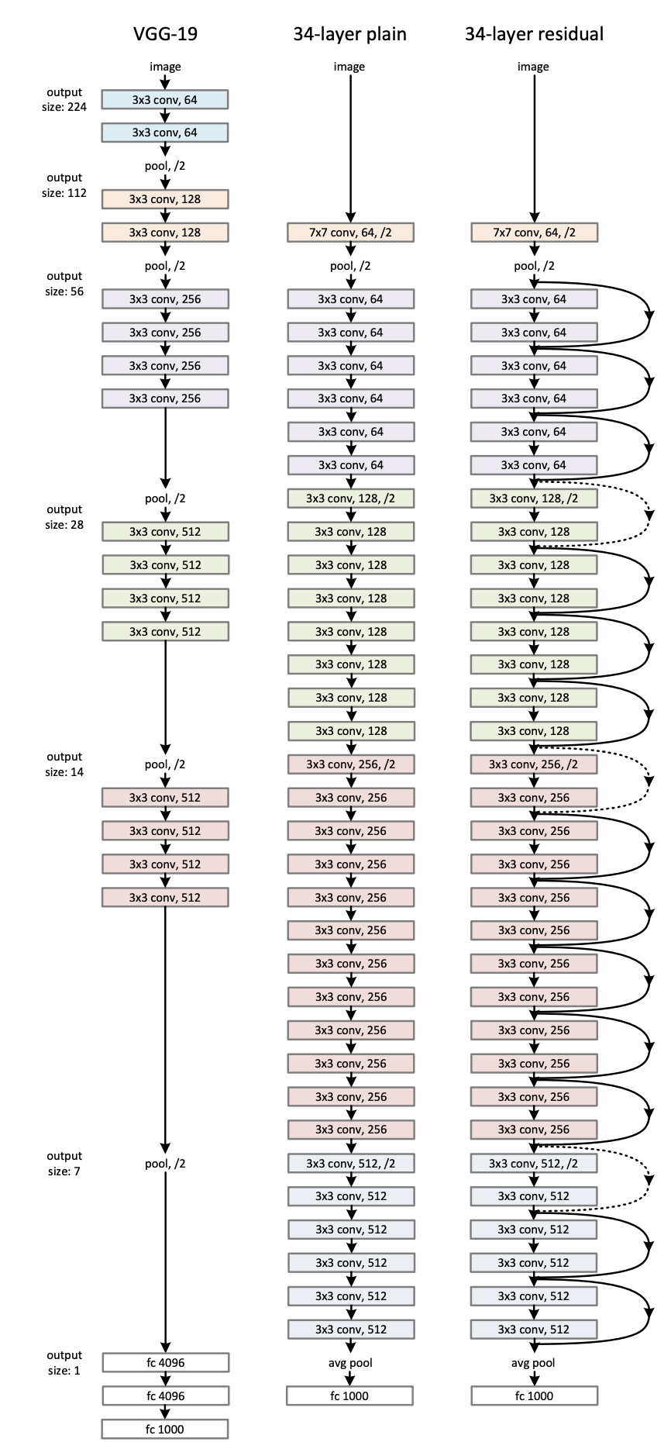
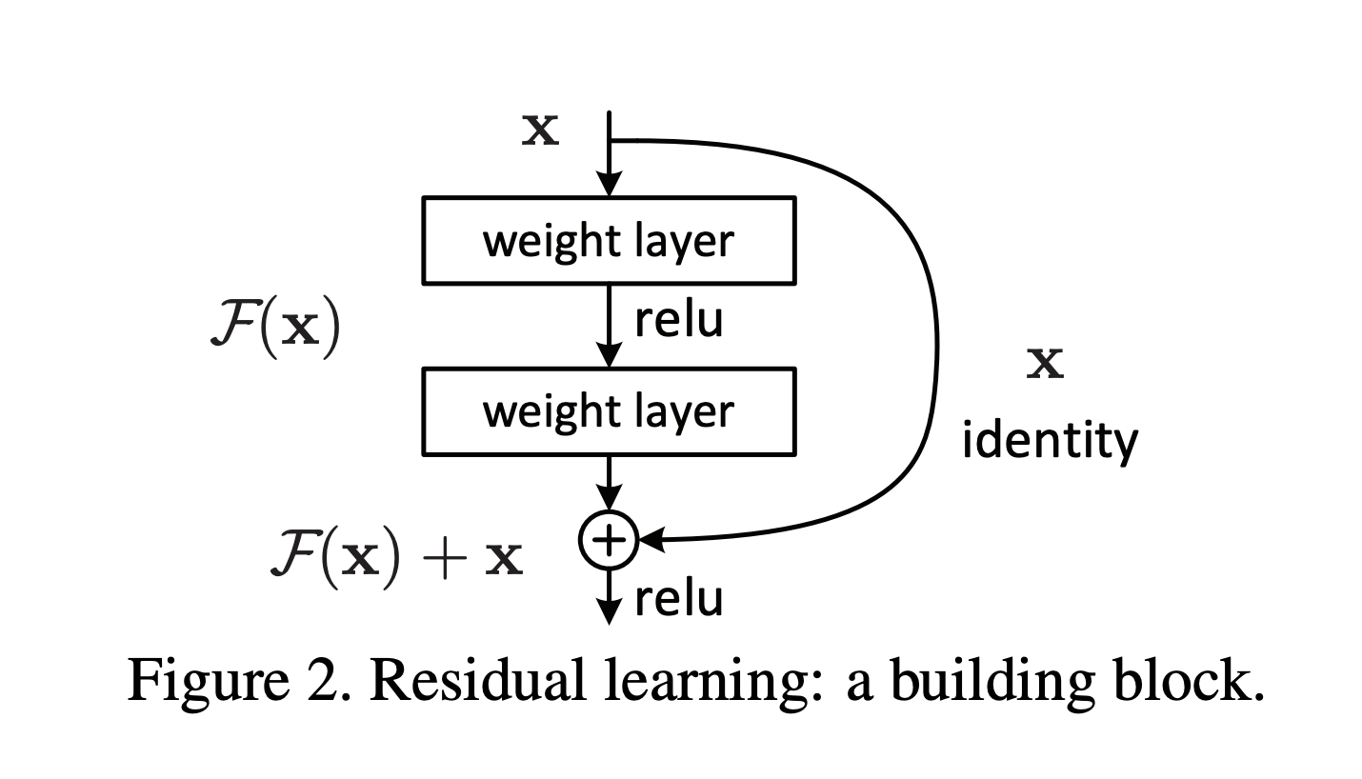
Classification: ResNet
Idea: Residual connections (Shortcuts)
Paper
Code: available in every framework

Slide 17
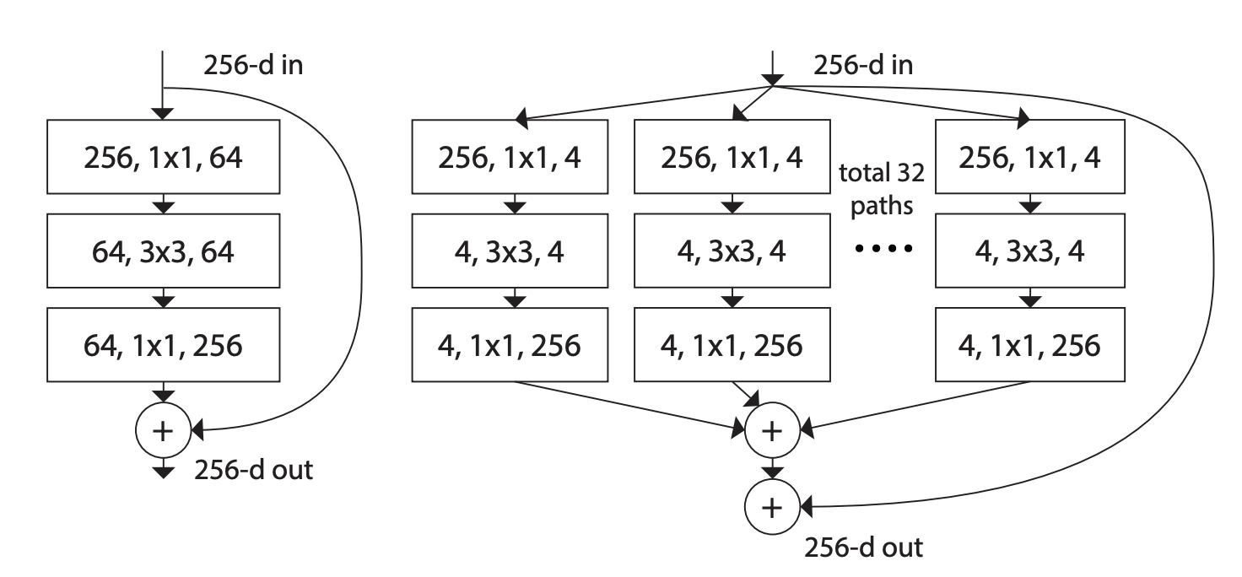
Classification: ResNeXt
Idea: Aggregated residual blocks
Paper
Code
Bottom: Cardinality (C) = 32, d = 4

Slide 18
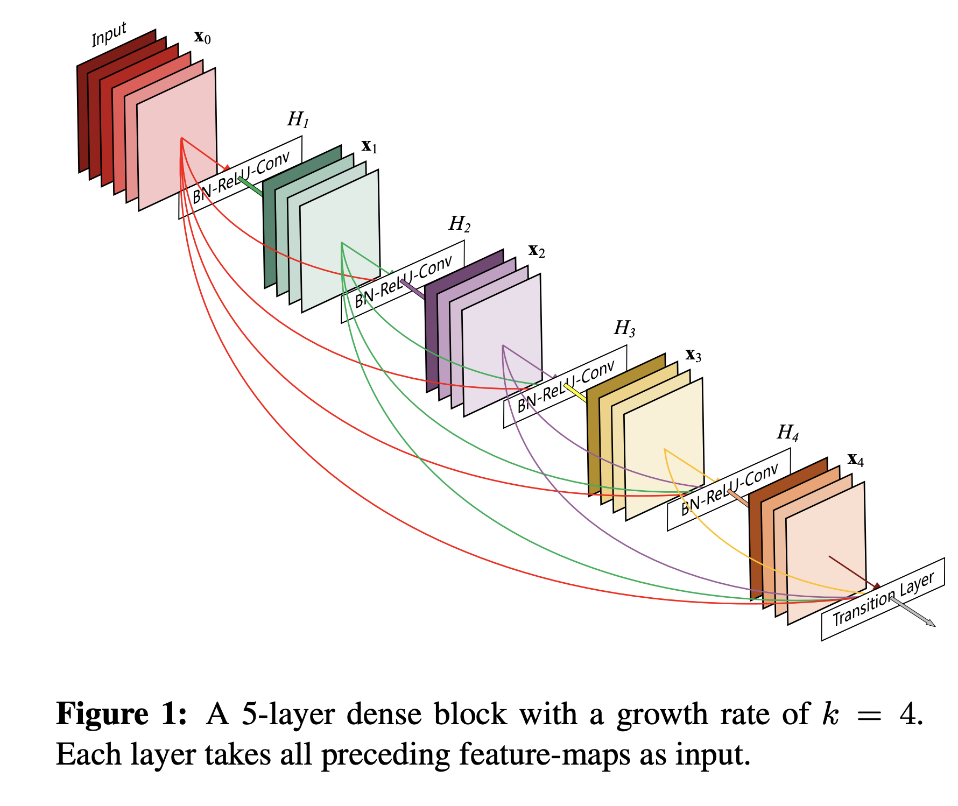
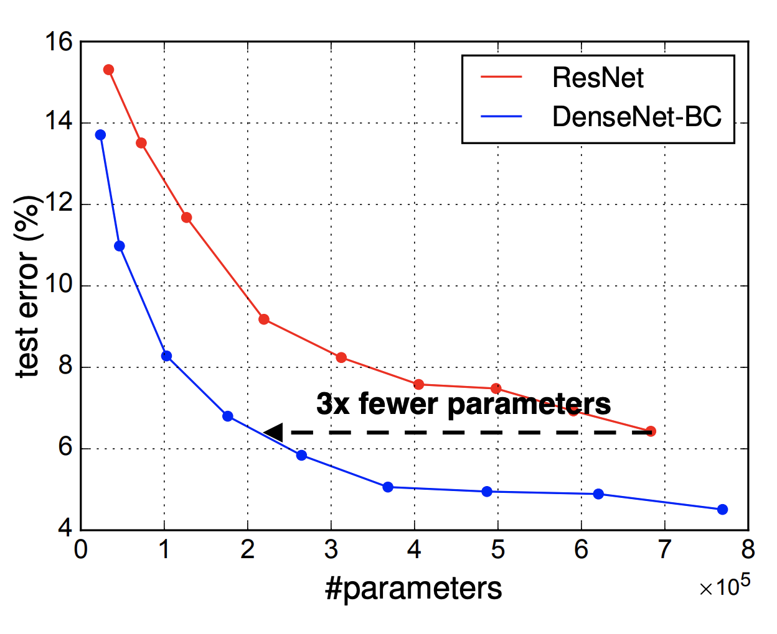
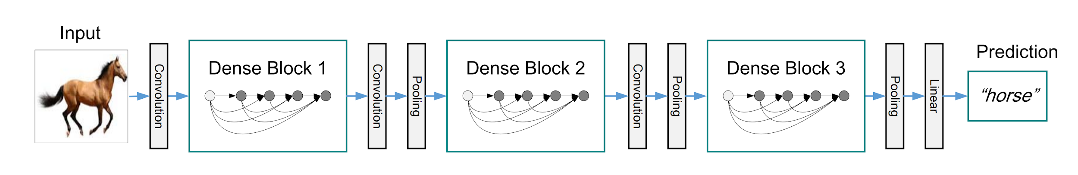
Classification: DenseNet
Idea: Dense block
Paper
Code: torchvision / tf.models

Slide 19
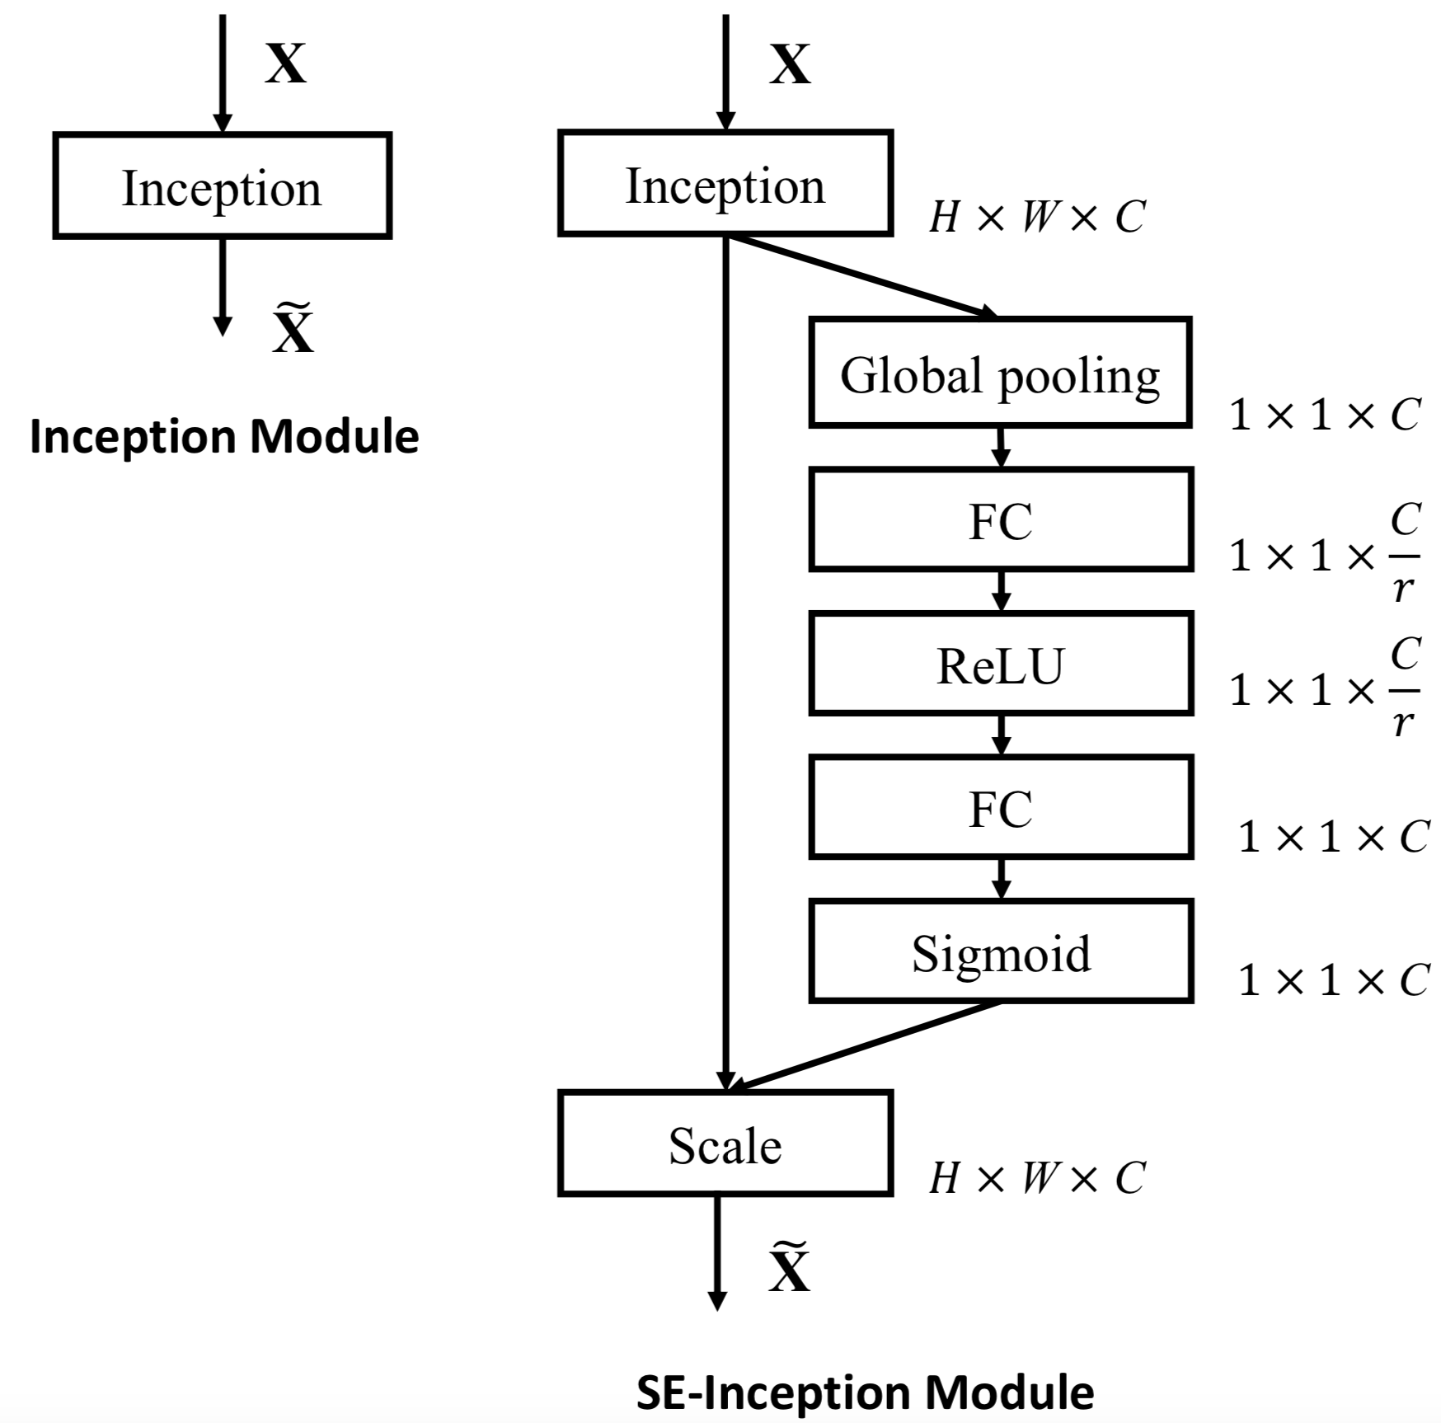
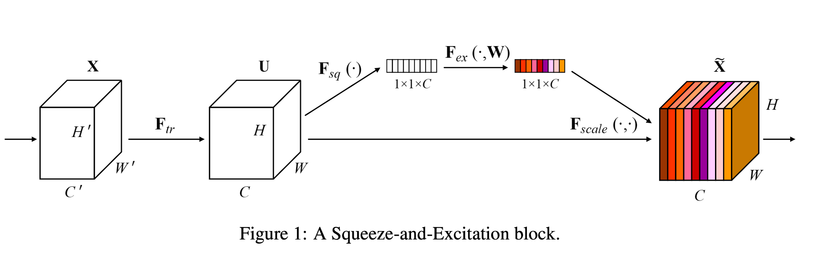
Classification: Squeeze-and-Excitation Net (SENet)
Idea: SE-block
Paper
Code

Slide 20
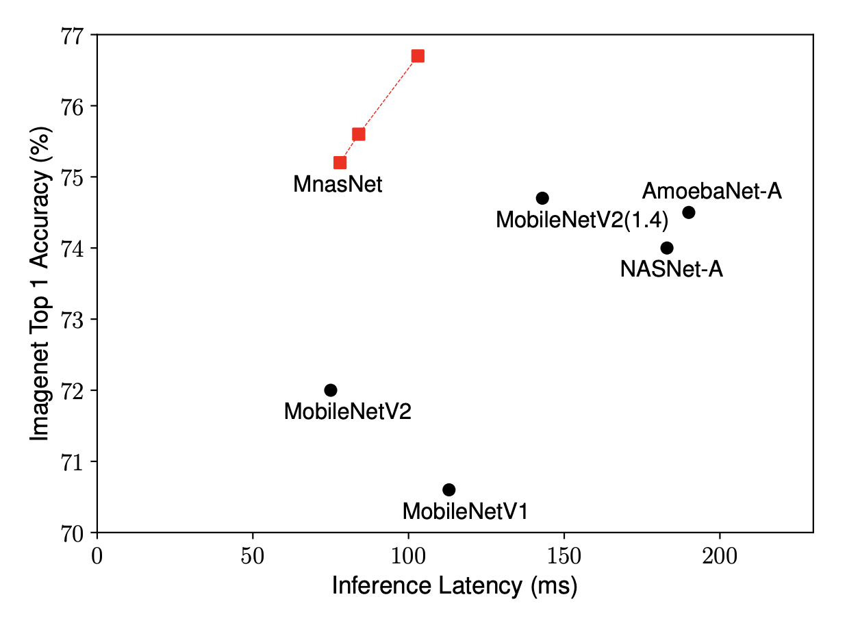
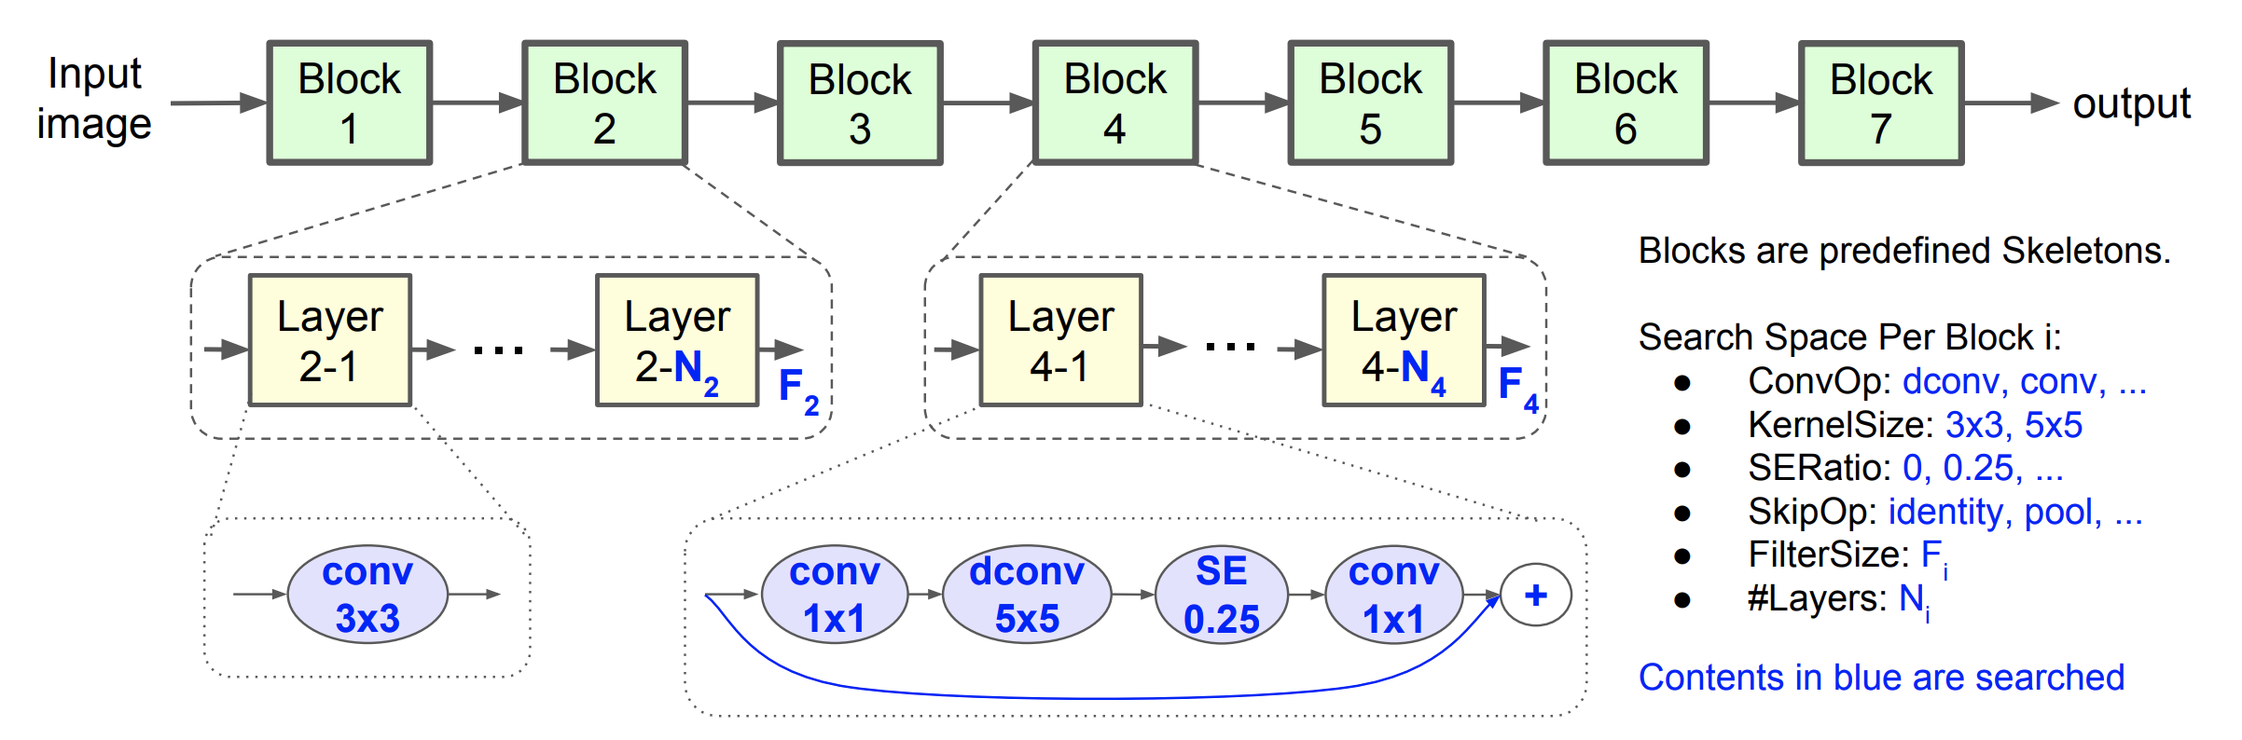
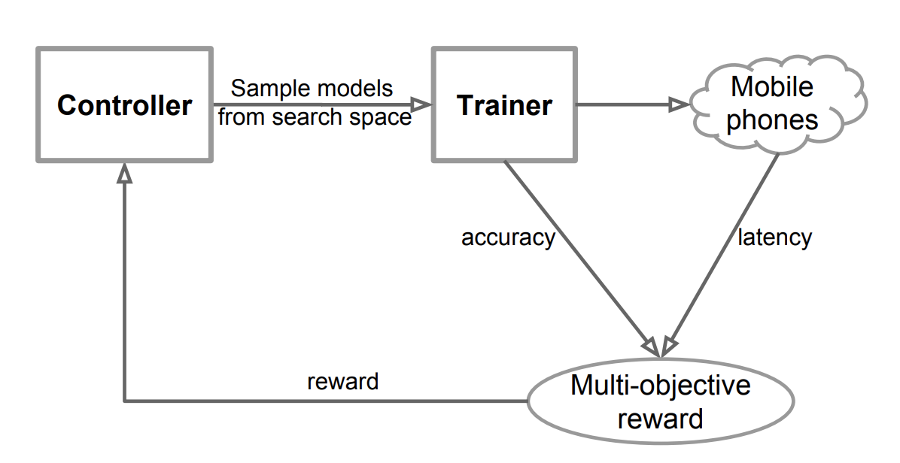
Classification: MnasNet
Idea: AutoML (Neural Architecture Search, NAS)
Paper
Code
Speed ~100ms on Mobile CPU (Pixel)

Slide 21
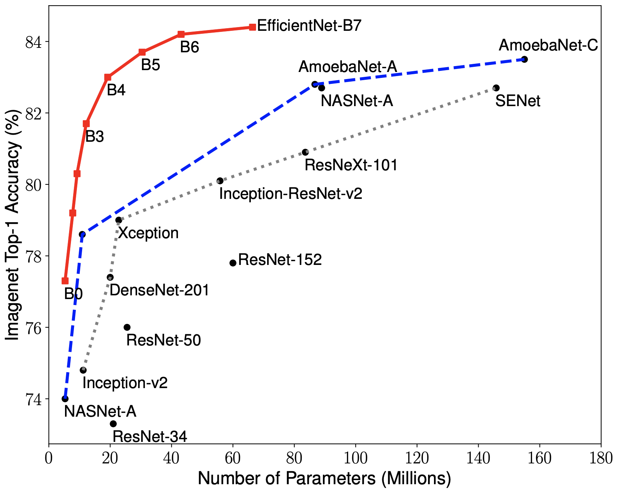
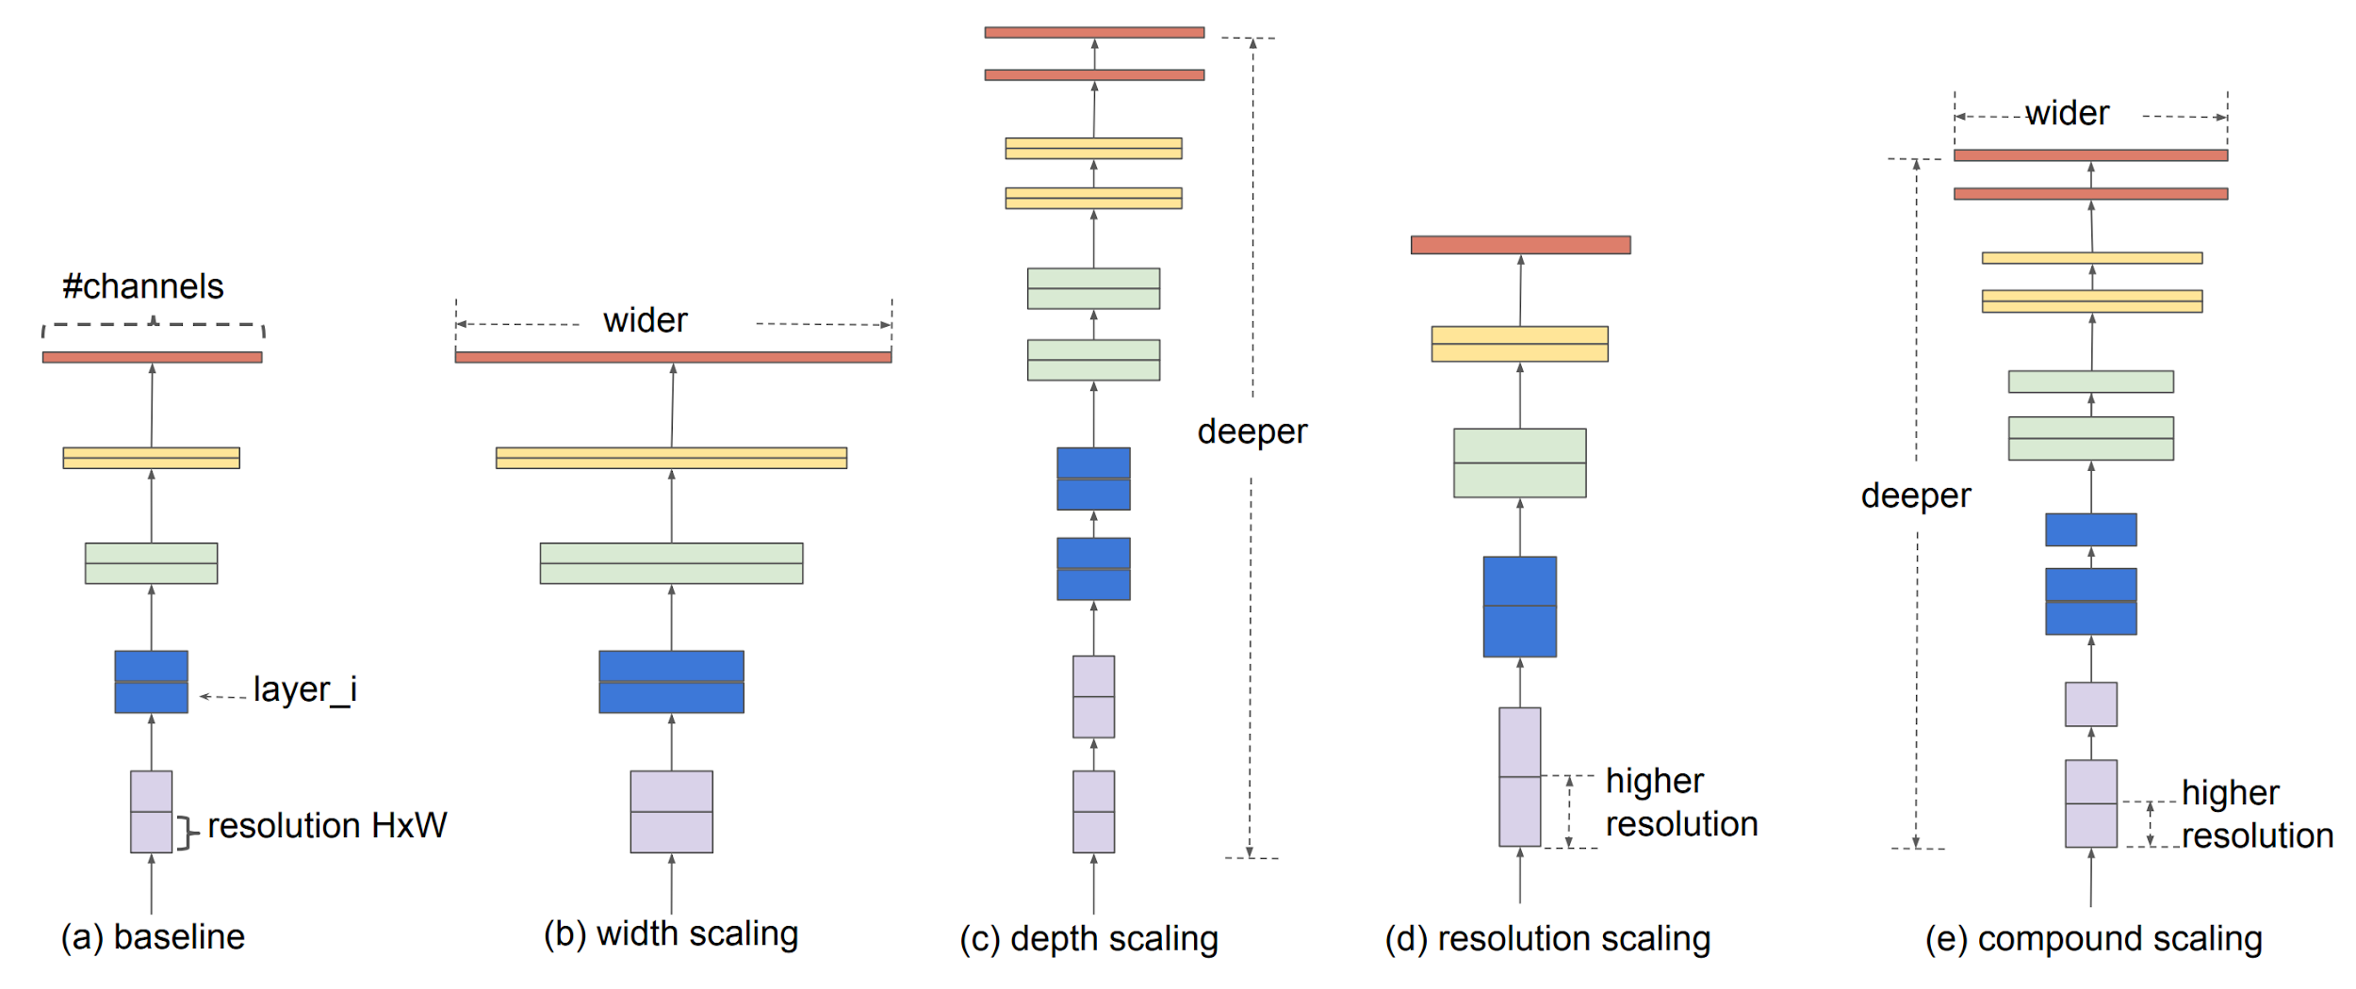
Classification: EfficientNet (2019)
Idea: AutoML + Compound scaling
Paper
Code

Slide 22
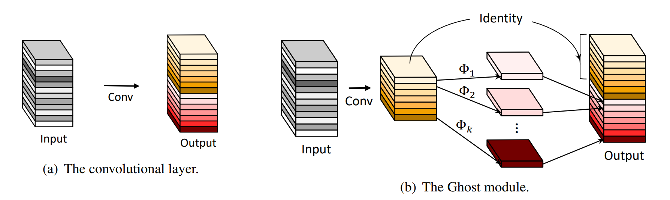
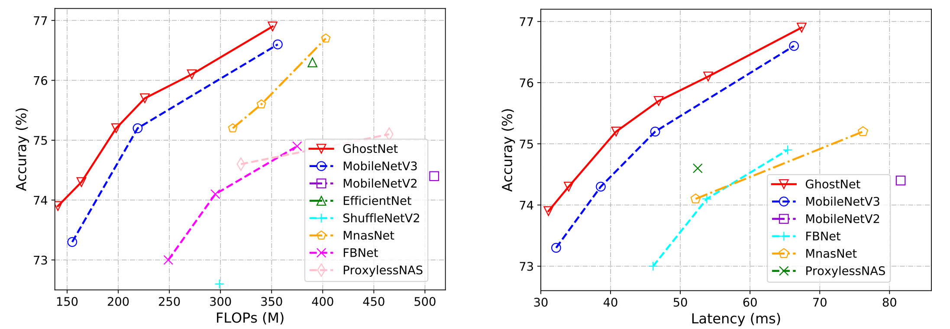
Classification: GhostNet (2019-2020)
Idea: Ghost module
Paper
Code

Slide 24
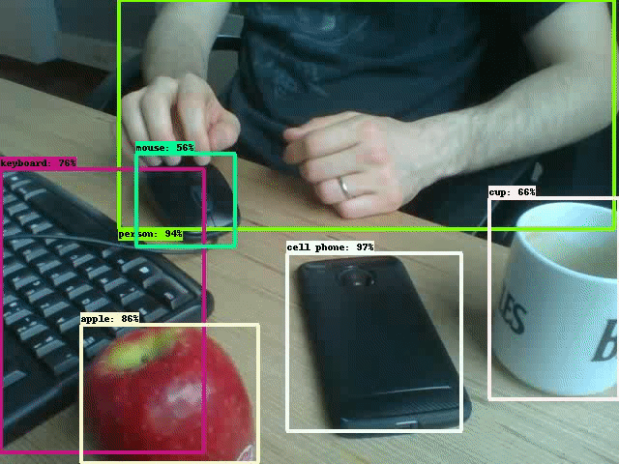
Detection
Datasets & Metrics

Slide 25
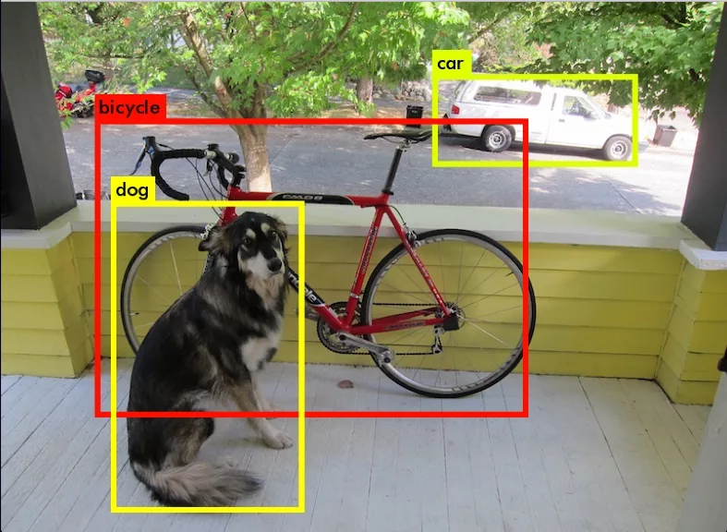
Object Detection: Task statement
Input: Image (np.array)
Output: “bounding boxes with class labels”
Each BBox is:
Top-Left corner: (x_tl, y_tl)
Bottom-Right corner: (x_br, y_br)
Class name
Confidence (probability of this class)
⇒ 6 numbers per each box

Slide 26

Object Detection: Data
PASCAL VOC 2012
MS COCO 2017
ImageNet
Google Open Images v6
Epic Kitchens

Slide 27
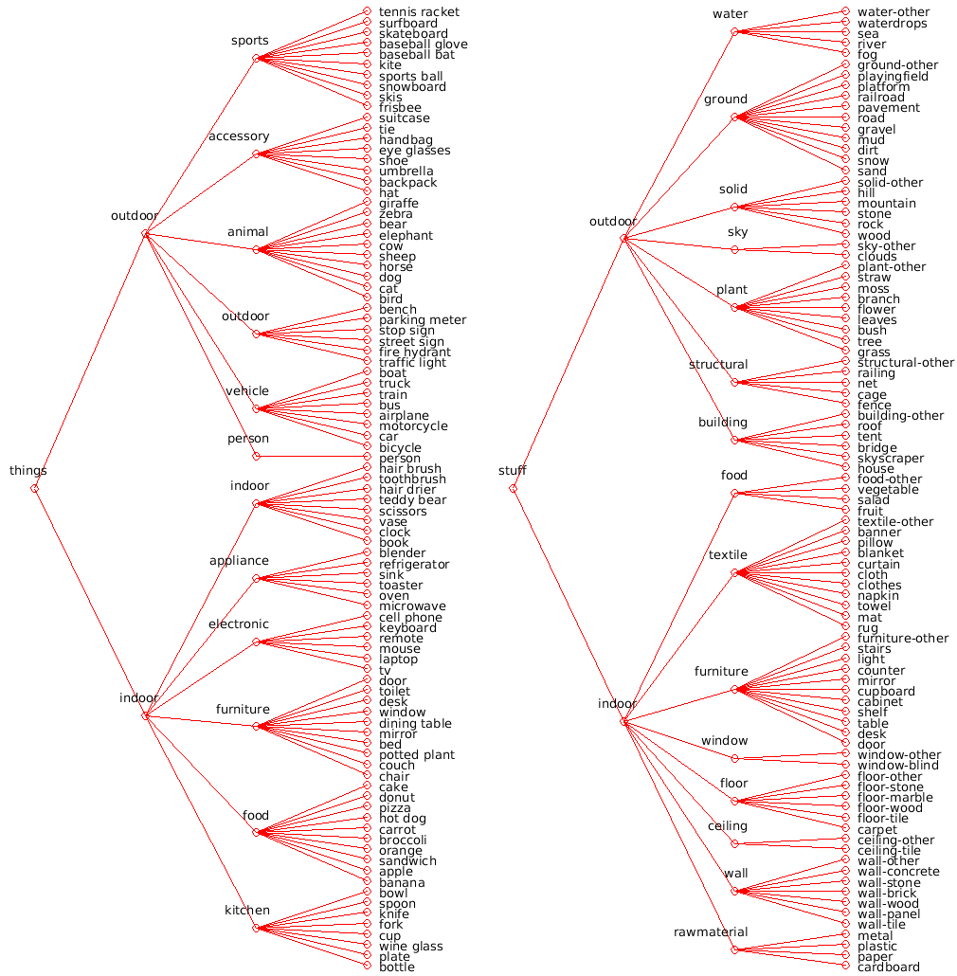
MS COCO 2017
MicroSoft Common Objects in COntext
80 classes
Train: ~120k images ~18GB
Val: ~5k images ~1GB
Test: ~40k images ~6GB
Vary in size and quality
Paper

Slide 28
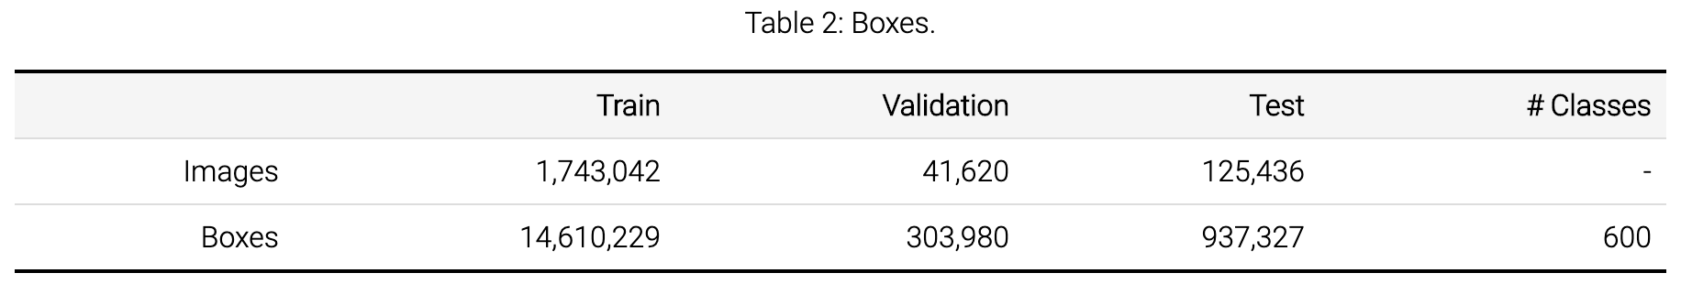
Google Open Images v6
Details:
https://storage.googleapis.com/openimages/web/factsfigures.html
Kaggle:
https://www.kaggle.com/c/open-images-object-detection-rvc-2020

Slide 29
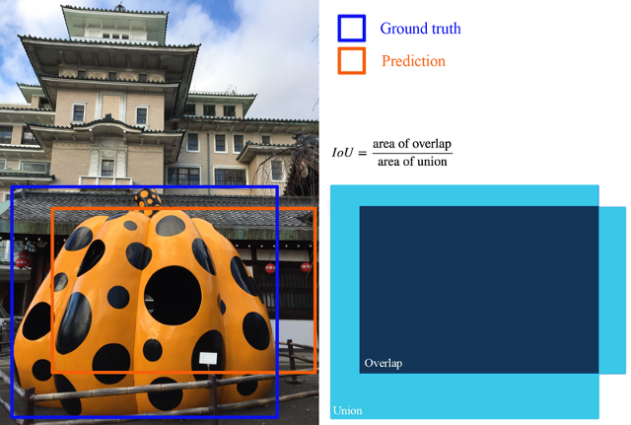
Intersection over Union (IoU, Jaccard index)

Slide 30
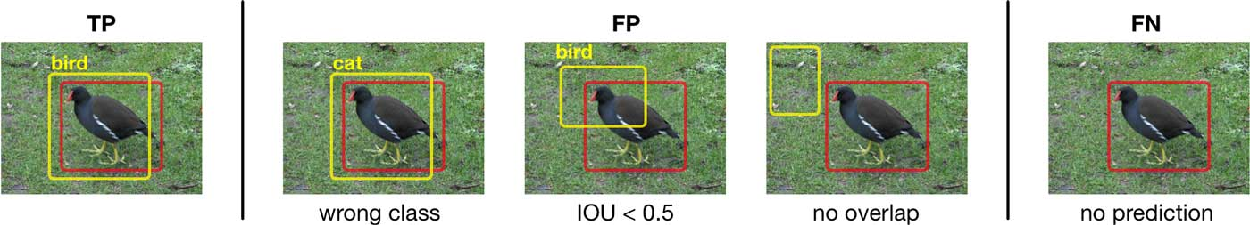
Positives & Negatives
https://machinethink.net/images/object-detection/tp-fp-fn@2x.jpg

Slide 31
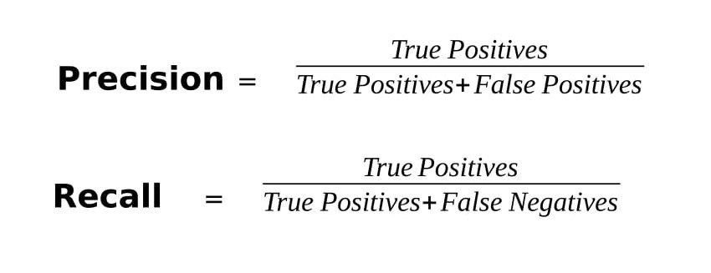
Precision, recall

Slide 32
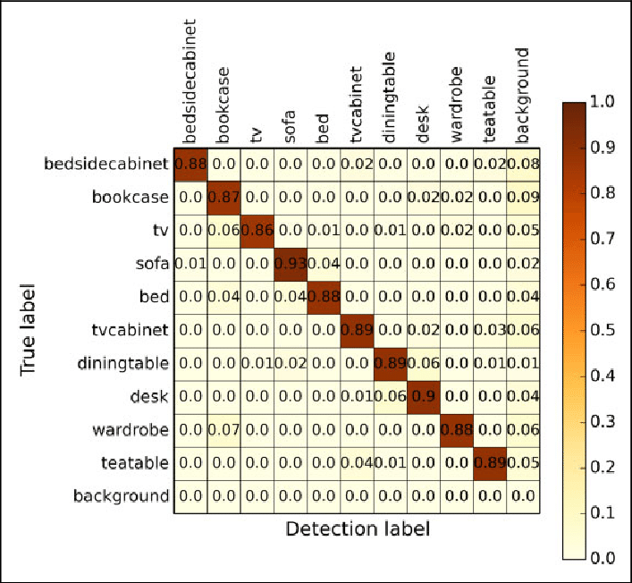
Confusion matrix
https://www.researchgate.net/publication/338728961/figure/fig2/AS:849968428507136@1579659673792/The-confusion-matrix-of-object-detection.png

Slide 33
mean Average Precision (mAP)
Good explanation

Slide 34
Let’s invent our own detector

Slide 35
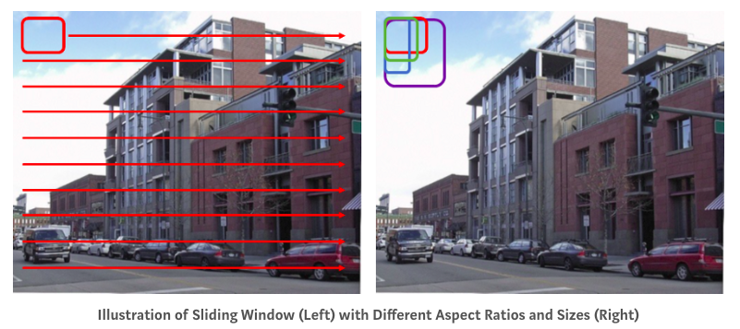
Let’s invent our own detector

Slide 36
Summary
Detection task is not easy
Datasets are quite large and accessible
Metrics are specific, but reasonable
Simple object detector invented

Slide 38
Two-stage detectors
RCNN, Fast-RCNN, Faster-RCNN

Slide 39
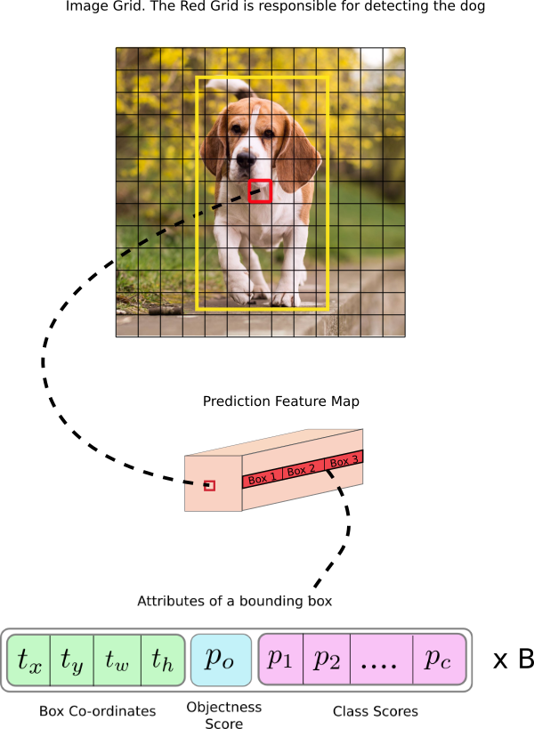
Detection: Core idea
Make default boxes assumptions
Regress their corners coordinates
Predict class inside each box
Filter not confident predictions

Slide 40
Detection: Core idea
Make default boxes assumptions “Anchor boxes”
Regress their corners coordinates Simultaneously
Predict class inside each box
Filter not confident predictions Non-max suppression (NMS)

Slide 41
Detection: Taxonomy
Detectors
Two-Stage (Proposal-based)
RCNN
Fast RCNN
Faster RCNN
Mask RCNN
One-Stage
SSD
YOLOv3
DSOD
RFBNet
Points-based
CenterNet
CornerNet
ExtremeNet
EfficientDet (NAS)
Time

Slide 42
Detection: Taxonomy
Detectors
Two-Stage (Proposal-based)
RCNN
Fast RCNN
Faster RCNN
Mask RCNN
One-Stage
SSD
YOLOv3
DSOD
RFBNet
Points-based
CenterNet
CornerNet
ExtremeNet
EfficientDet (NAS)
Time

Slide 43
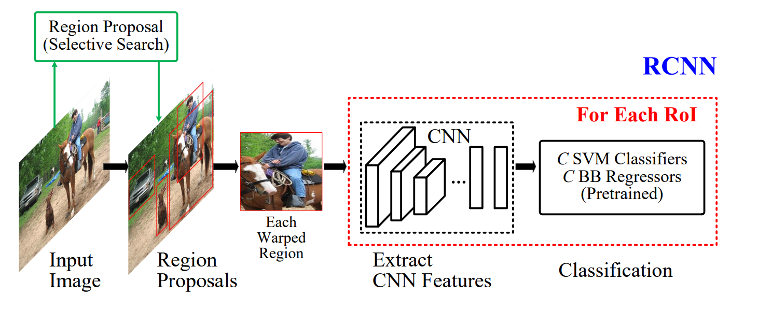
Detection: Two-stage (proposal-based)
https://arxiv.org/abs/1905.05055

Slide 44
Detection: Two-stage (proposal-based)
Generate boxes proposals (with separate algorithm / net)
https://arxiv.org/abs/1905.05055

Slide 45
Detection: Two-stage (proposal-based)
Generate boxes proposals (with separate algorithm / net)
Warp them to one shape
https://arxiv.org/abs/1905.05055

Slide 46
Detection: Two-stage (proposal-based)
Generate boxes proposals (with separate algorithm / net)
Warp them to one shape
Regress and classify them (with another algorithm)
https://arxiv.org/abs/1905.05055

Slide 47
Detection: Two-stage (proposal-based)
Generate boxes proposals (with separate algorithm / net)
Warp them to one shape
Regress and classify them (with another algorithm)
Post-process predictions
https://arxiv.org/abs/1905.05055

Slide 48
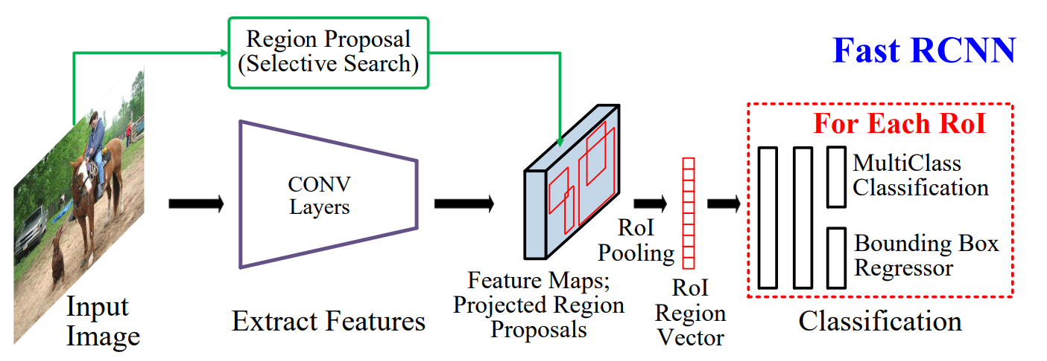
Detection: Two-stage (proposal-based)
Generate boxes proposals (with separate algorithm / net)
Warp them to one shape
Regress and classify them (with another algorithm)
Post-process predictions
https://arxiv.org/abs/1905.05055

Slide 49
Detection: Backbone
Generate boxes proposals (with separate algorithm / net)
Warp them to one shape
Regress and classify them (with another algorithm)
Post-process predictions
Backbone
https://arxiv.org/abs/1905.05055

Slide 50
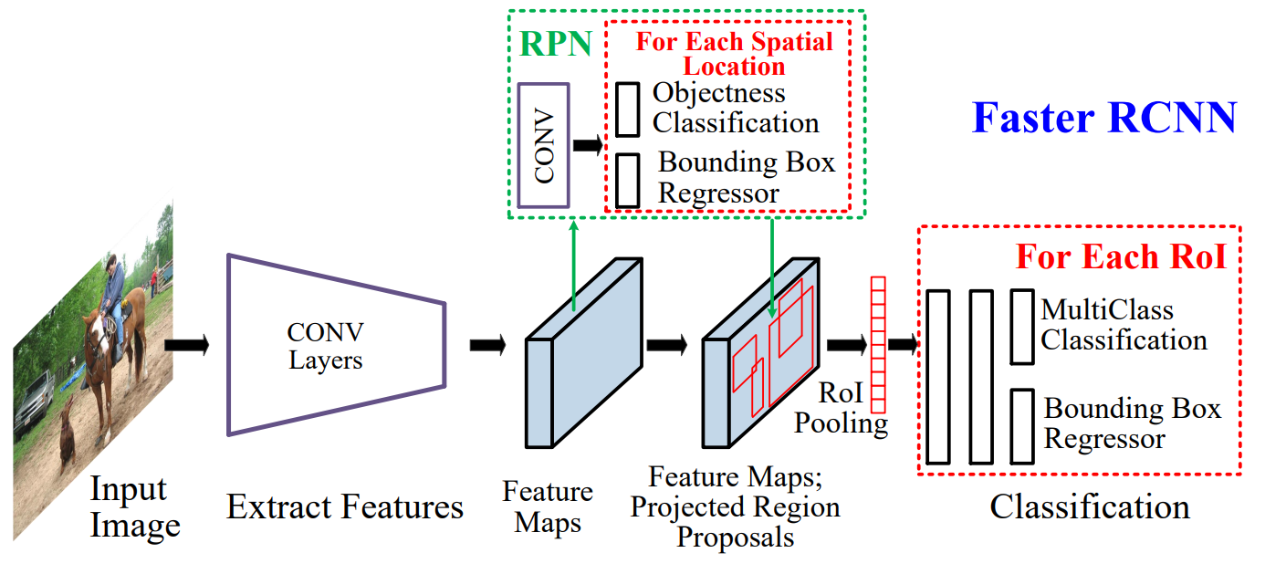
Detection: Two-stage (proposal-based)
Generate boxes proposals (with separate algorithm / net)
Warp them to one shape
Regress and classify them (with another algorithm)
Post-process predictions
https://arxiv.org/abs/1905.05055

Slide 51
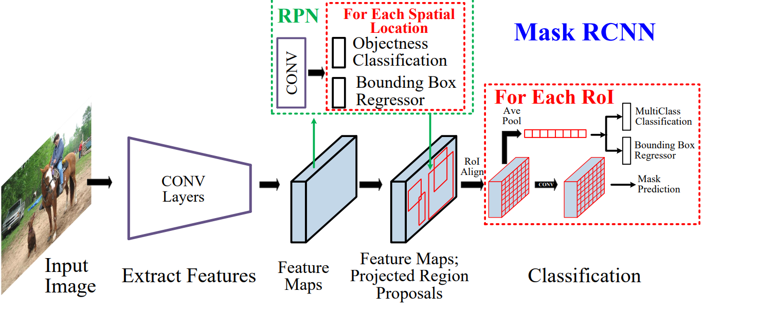
Detection: Two-stage (proposal-based)
Generate boxes proposals (with separate algorithm / net)
Warp them to one shape
Regress and classify them (with another algorithm)
Post-process predictions
https://arxiv.org/abs/1905.05055

Slide 52
Summary
Core ideas
Two-stage detectors

Slide 54
One-stage detectors
SSD, YOLO

Slide 55
Detection: Taxonomy
Detectors
Two-Stage (Proposal-based)
RCNN
Fast RCNN
Faster RCNN
Mask RCNN
One-Stage
SSD
YOLOv3
DSOD
RFBNet
Points-based
CenterNet
CornerNet
ExtremeNet
EfficientDet (NAS)
Time

Slide 56
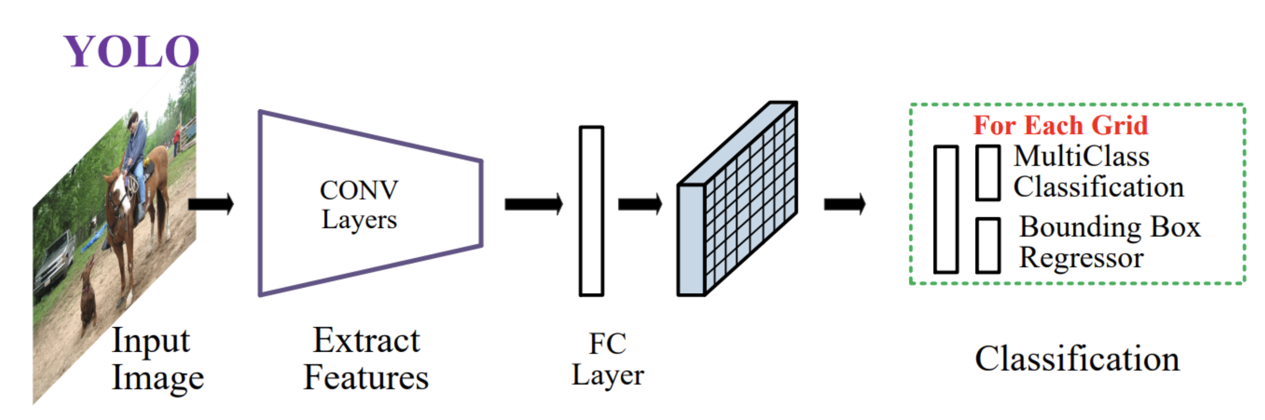
Detection: You Only Look Once
Get features from a Backbone Network
Predict feature map (“grid”)
Predict boxes from grid
Post-process predictions
https://arxiv.org/abs/1905.05055

Slide 57
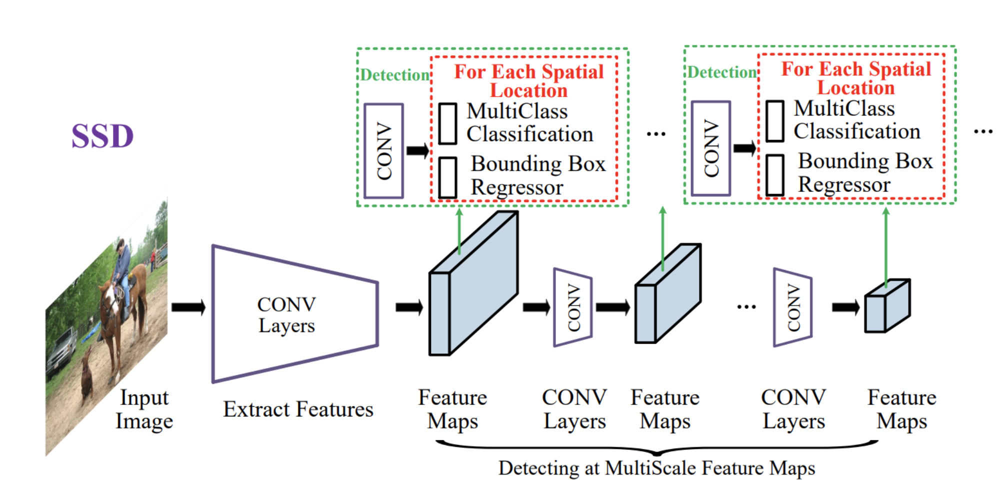
Detection: Single-Shot Multibox Detector (SSD)
Get features from a Backbone Network
Predict feature map (“grid”)
Predict boxes from grid
Post-process predictions
https://arxiv.org/abs/1905.05055

Slide 58
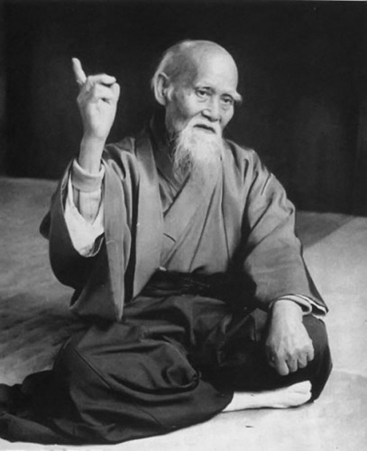
“Hone one thing,
but to the ideal”
Some clever person

Slide 59
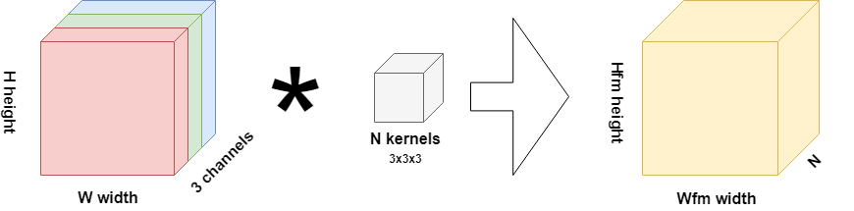
Convolutions: recap
cell
image
conv kernels (filters)
feature map
Notes:
Image, Conv, Pool, Shortcut, Feature map, conv6_4, Feature map Cell, Receptive field

Slide 60
Convolutions: recap
cell
image
conv kernels (filters)
feature map
Notes:
Image, Conv, Pool, Shortcut, Feature map, conv6_4, Feature map Cell, Receptive field

Slide 61
Convolutions: recap
image
conv kernels (filters)
feature map
Notes:
Image, Conv, Pool, Shortcut, Feature map, conv6_4, Feature map Cell, Receptive field

Slide 62
Convolutions: recap
cell
image
conv kernels (filters)
feature map
Notes:
Image, Conv, Pool, Shortcut, Feature map, conv6_4, Feature map Cell, Receptive field

Slide 63
SSD: up-to-bottom explanation
SSD pipeline
Input: image (h,w,3) → Backbone
Backbone → feature map
Feature map → boxes locations and classes inside of them
Detection task
How many boxes?
What should be the size of an input image?
How to train? (~ how to make it differentiable?)

Slide 64
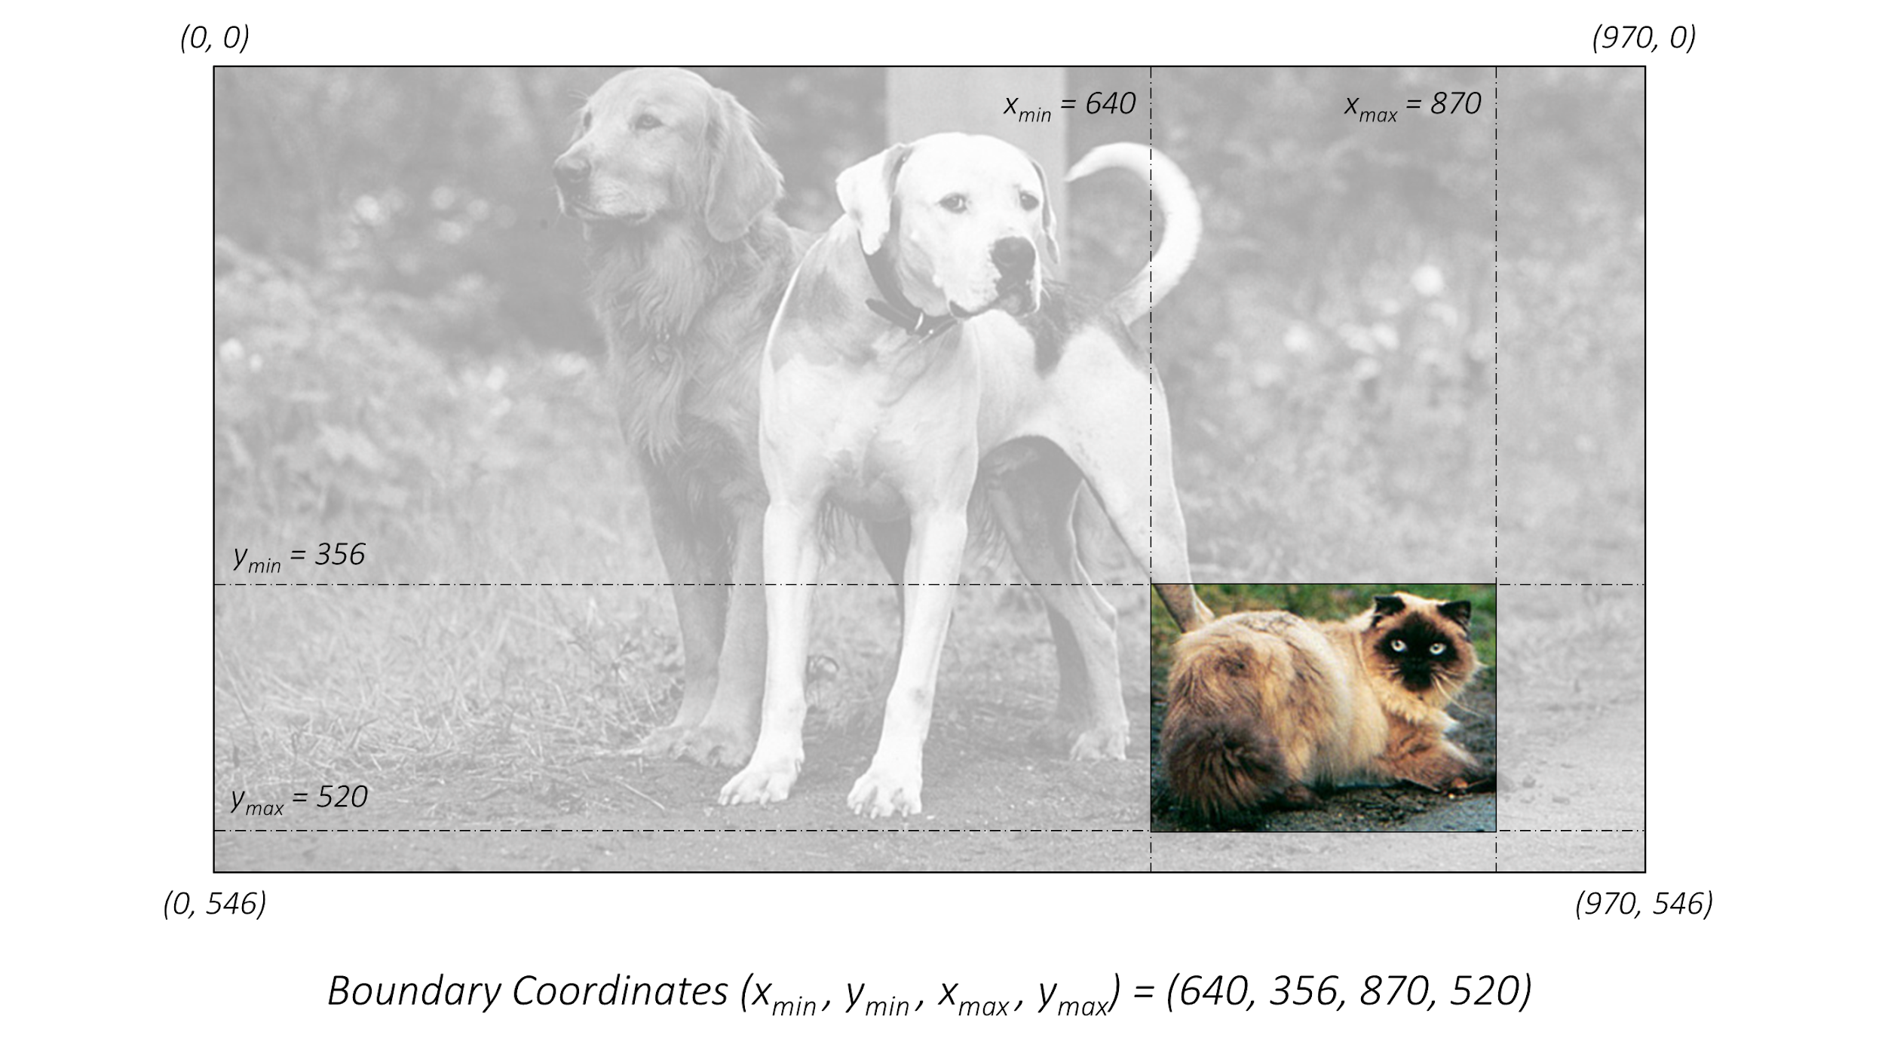
SSD: tlrb format
https://github.com/sgrvinod/a-PyTorch-Tutorial-to-Object-Detection

Slide 65
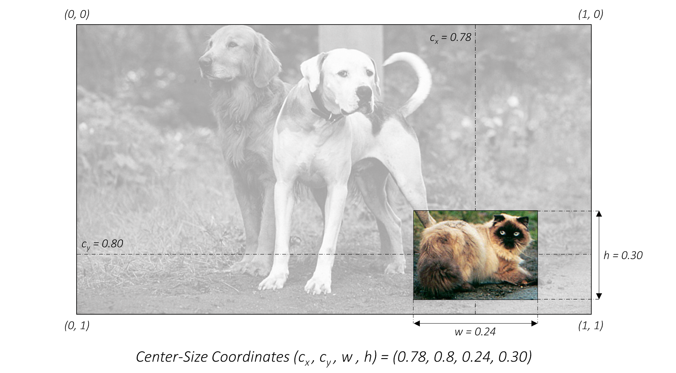
SSD: xywh format
https://github.com/sgrvinod/a-PyTorch-Tutorial-to-Object-Detection

Slide 66
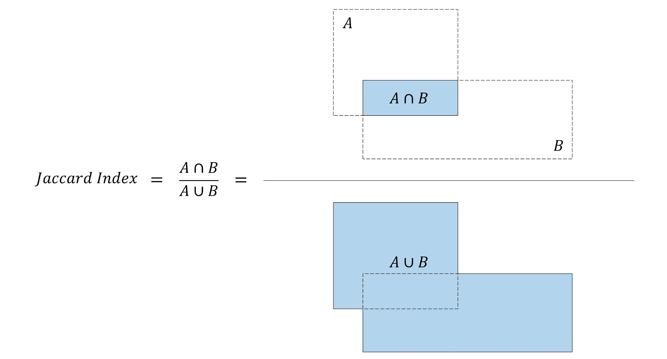
SSD: Intersection over Union
https://github.com/sgrvinod/a-PyTorch-Tutorial-to-Object-Detection

Slide 67
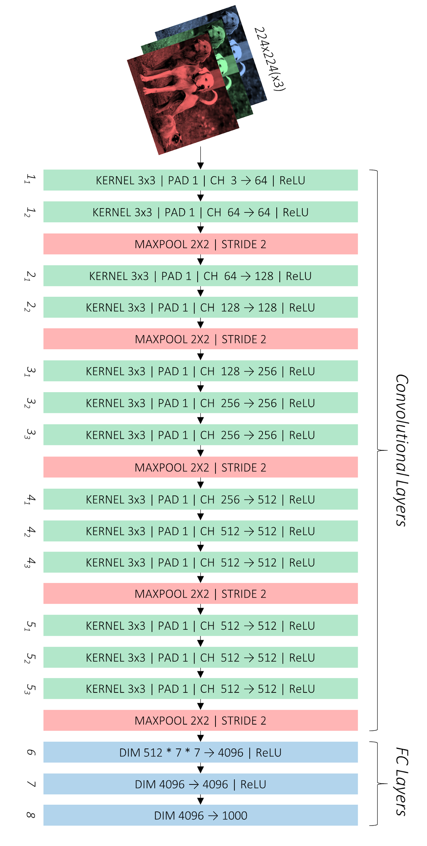
SSD: VGG
https://github.com/sgrvinod/a-PyTorch-Tutorial-to-Object-Detection

Slide 68
SSD: VGG
https://github.com/sgrvinod/a-PyTorch-Tutorial-to-Object-Detection

Slide 69

SSD
https://github.com/sgrvinod/a-PyTorch-Tutorial-to-Object-Detection

Slide 70
SSD: VGG
https://github.com/sgrvinod/a-PyTorch-Tutorial-to-Object-Detection

Slide 71
SSD: VGG
Auxiliary Layers
https://github.com/sgrvinod/a-PyTorch-Tutorial-to-Object-Detection

Slide 72

SSD: auxiliary (“extra”) layers
https://github.com/sgrvinod/a-PyTorch-Tutorial-to-Object-Detection

Slide 73
SSD: feature maps
https://github.com/sgrvinod/a-PyTorch-Tutorial-to-Object-Detection

Slide 74
SSD
Each of these feature maps’ cells has 4-6 “default boxes”
https://github.com/sgrvinod/a-PyTorch-Tutorial-to-Object-Detection

Slide 75

SSD: “default boxes” of one cell
Each of these feature maps’ cells has 4-6 “default boxes”
https://github.com/sgrvinod/a-PyTorch-Tutorial-to-Object-Detection

Slide 76

SSD: number of default boxes
https://github.com/sgrvinod/a-PyTorch-Tutorial-to-Object-Detection

Slide 77

SSD: prediction convolutions
https://github.com/sgrvinod/a-PyTorch-Tutorial-to-Object-Detection

Slide 78

SSD: prediction scheme
https://github.com/sgrvinod/a-PyTorch-Tutorial-to-Object-Detection

Slide 79

SSD: location coordinates channels
https://github.com/sgrvinod/a-PyTorch-Tutorial-to-Object-Detection

Slide 80

SSD: classification score channels
https://github.com/sgrvinod/a-PyTorch-Tutorial-to-Object-Detection

Slide 81

SSD: boxes of FM 9
https://github.com/sgrvinod/a-PyTorch-Tutorial-to-Object-Detection

Slide 82

SSD: all predicted boxes
https://github.com/sgrvinod/a-PyTorch-Tutorial-to-Object-Detection

Slide 83

SSD: predictions
https://github.com/sgrvinod/a-PyTorch-Tutorial-to-Object-Detection

Slide 84

SSD: matching
https://github.com/sgrvinod/a-PyTorch-Tutorial-to-Object-Detection

Slide 85

SSD: coordinate regression loss
https://github.com/sgrvinod/a-PyTorch-Tutorial-to-Object-Detection

Slide 86

SSD: coordinate regression loss
https://github.com/sgrvinod/a-PyTorch-Tutorial-to-Object-Detection

Slide 87

SSD: classification loss + hard negative mining
https://github.com/sgrvinod/a-PyTorch-Tutorial-to-Object-Detection

Slide 88
SSD: classification loss + hard negative mining
https://github.com/sgrvinod/a-PyTorch-Tutorial-to-Object-Detection

Slide 89
SSD: classification loss + hard negative mining
N_hard_negatives = 3 * N_positives
https://github.com/sgrvinod/a-PyTorch-Tutorial-to-Object-Detection

Slide 90
SSD: full multibox loss
N_hard_negatives = 3 * N_positives
https://github.com/sgrvinod/a-PyTorch-Tutorial-to-Object-Detection

Slide 91

Detection: non-max suppression
For each class separately!

Slide 92

Detection: non-max suppression
https://github.com/sgrvinod/a-PyTorch-Tutorial-to-Object-Detection

Slide 93

Detection: non-max suppression
https://github.com/sgrvinod/a-PyTorch-Tutorial-to-Object-Detection

Slide 94
Summary
One-stage detectors
In-depth SSD architecture

Slide 96
Modern approaches
State-of-the-Art

Slide 97
Detection: Taxonomy
Detectors
Two-Stage (Proposal-based)
RCNN
Fast RCNN
Faster RCNN
Mask RCNN
One-Stage
SSD
YOLOv3
DSOD
RFBNet
Points-based
CenterNet
CornerNet
ExtremeNet
EfficientDet (NAS)
Time

Slide 98

Incremental improvement: YOLOv3 (2018)
https://pjreddie.com/darknet/yolo

Slide 99

Incremental improvement: YOLOv3 (2018)

Slide 100

Optimal detection: YOLOv4 (2020)
https://habr.com/ru/post/503200/

Slide 101

Optimal detection: YOLOv4 (2020)
https://habr.com/ru/post/503200/

Slide 102


Objects as Points: CenterNet (2019)
https://arxiv.org/abs/1904.07850

Slide 103


NAS in Detection: EfficientDet (2019-2020)
Idea: EfficientNet + BiFPN
https://github.com/google/automl/tree/master/efficientdet

Slide 104
Modern tasks
Specific detection applications

Slide 105
In real life we need to
Detect people
Detect faces
Detector text
Do tracking through the video (time), not only image
Recognize actions: proxy, end-to-end
Detect in 3D: self-driving, robotics, VR/AR

Slide 106

In real life we need to: detect people

Slide 107

In real life we need to: detect faces

Slide 108

In real life we need to: detect text

Slide 109

In real life we need to: do tracking

Slide 110

In real life we need to: recognize actions
https://github.com/facebookresearch/SlowFast

Slide 111


In real life we need to: detect in 3D
https://google.github.io/mediapipe/solutions/objectron

Slide 112

Solutions to these tasks
https://habr.com/ru/company/mipt/blog/458190/

Slide 113
Lecture summary
Classification recap
Object Detection basics
Two-stage (proposal-based) methods
One-stage (single-shot) methods
Modern approaches & tasks

